Slide 1
Learning from Artificial Demonstrations
Lioba Heimbach
Seminar in Deep Reinforcement Learning
ETH Zürich
Mar 26 2019
student by Adrien Coquet from the Noun Project

Slide 2
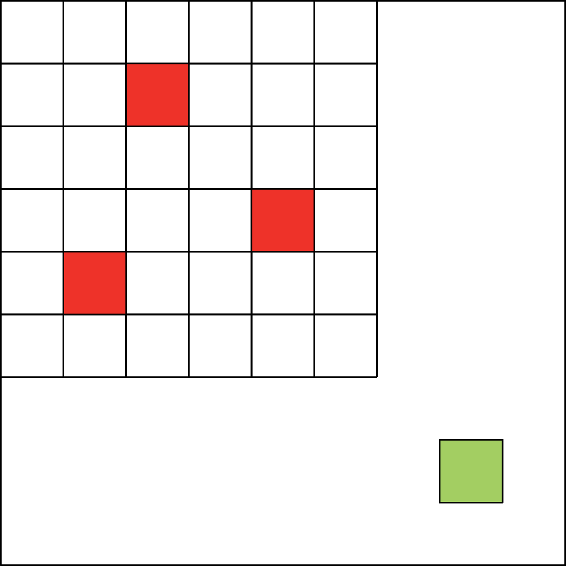
Learning from Artificial Demonstrations
Sparse Reward Environments
unlikely to encounter rewards
rewards discounted in long time horizon
${100}^{18}$ possibilites

Slide 3
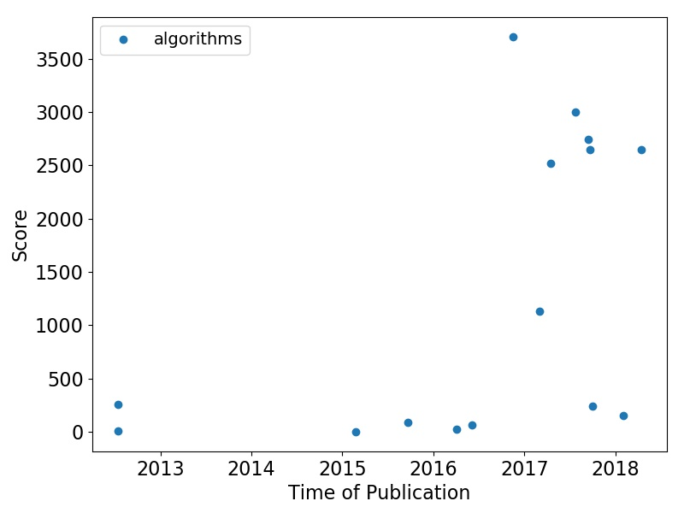
Historical Progress on Montezuma’s Revenge
BASS-hash
IMPALA
UBE
DQfD
Reactor
C51
DQN-PixelCN
SARSA
ES
DQN
DDQN
DQN-CTS
Linear
A3C
Ape-X

Slide 4
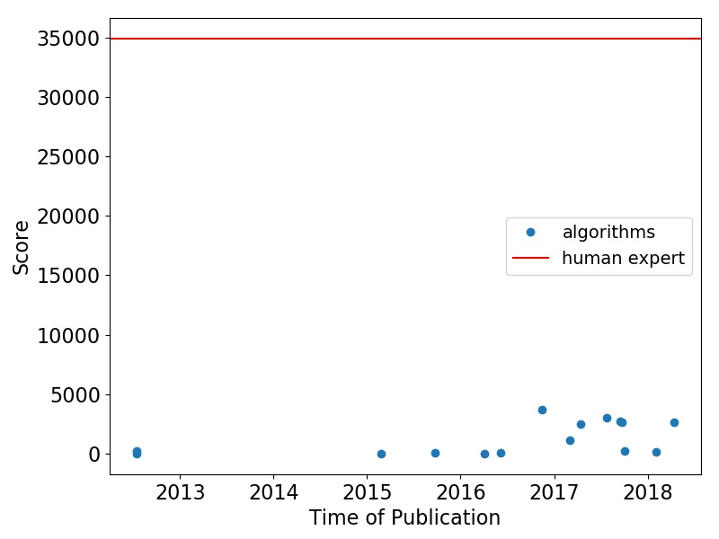
Historical Progress on Montezuma’s Revenge

Slide 5
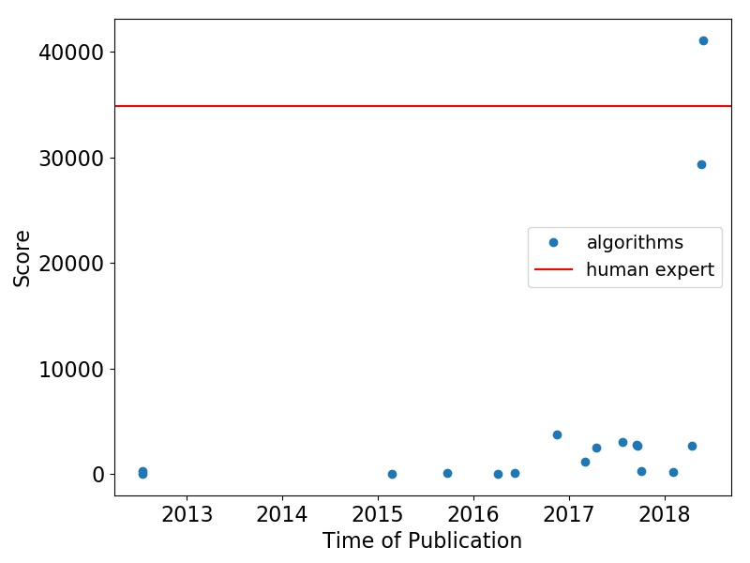
Historical Progress on Montezuma’s Revenge
focus of first part of presentation
TDC+CMC
Ape-X DQfD

Slide 6
Playing hard exploration games by watching YouTube
Yusuf Aytar, Tobias Paff, David Budden, Tom Le Paine, Ziyu Wang, Nando de Freitas
Kickstarting Deep Reinforcement Learning
Simon Schmitt, Jonathan J. Hudson, Augusting Zidek, Simon Osindero, Carl Doersch, Wojciech M. Czarnecki, Joel Z. Leibo, Heinrich Kuttler, Andrew Zisserman, Karen Simonyan, S. M. Ali Eslami
learning hard exploration games from YouTube videos
kickstarting agents using previously trained experts

Slide 7
Playing hard exploration games by watching YouTube
Kickstarting Deep Reinforcement Learning
learning hard exploration games from YouTube videos

Slide 8
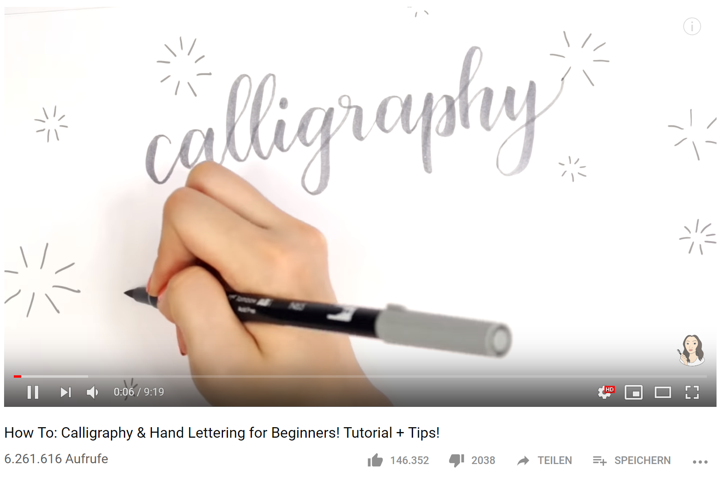
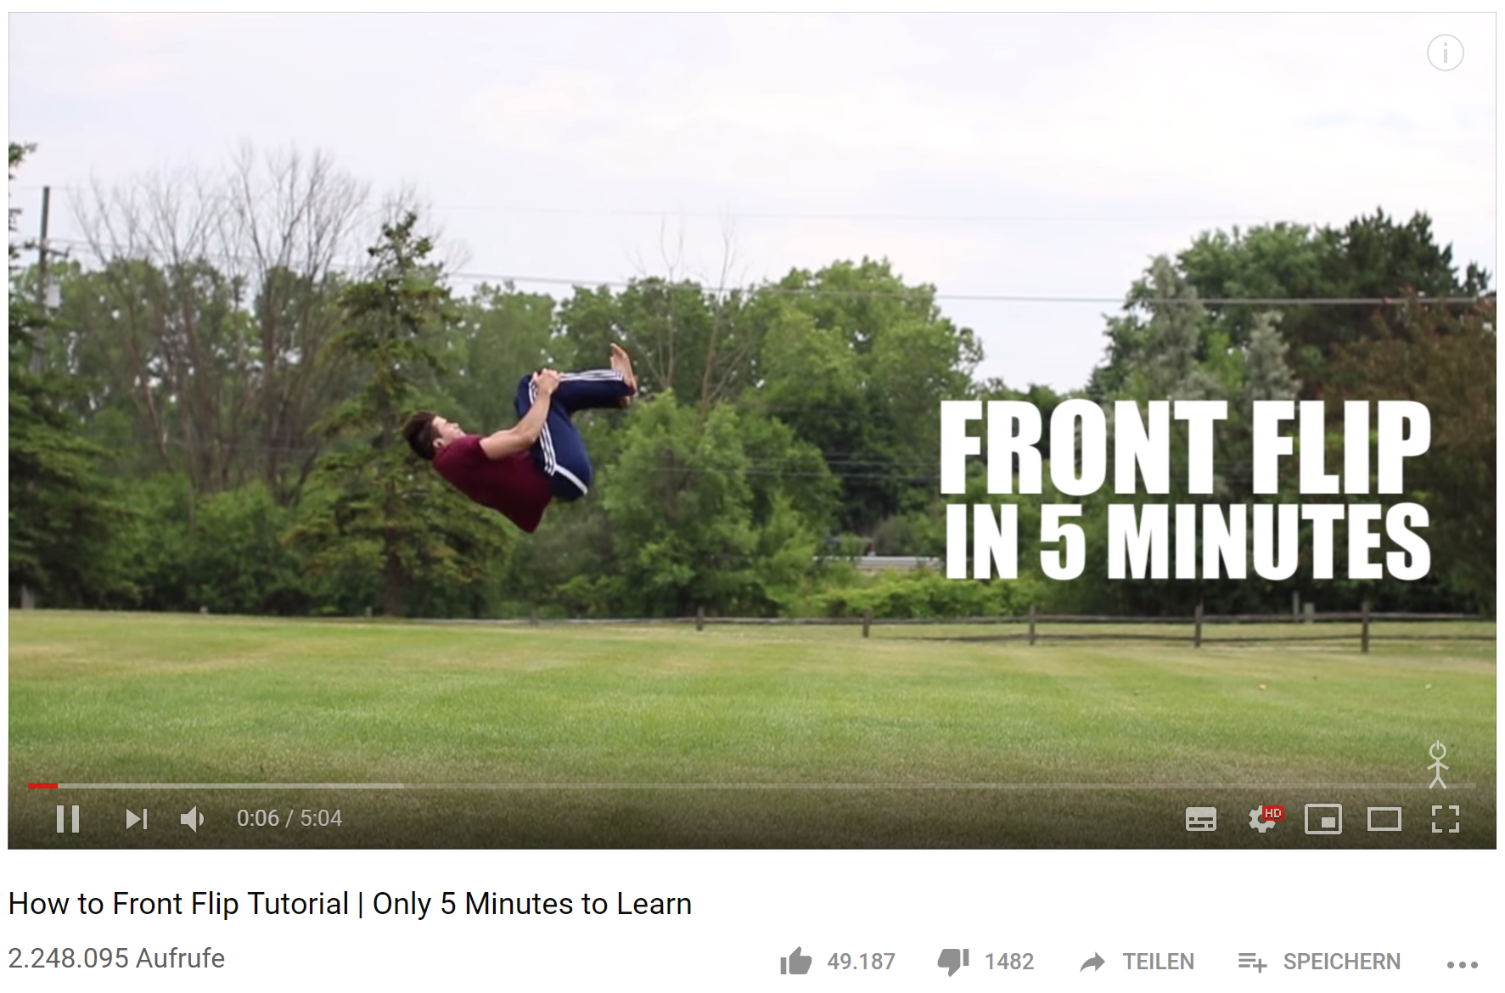
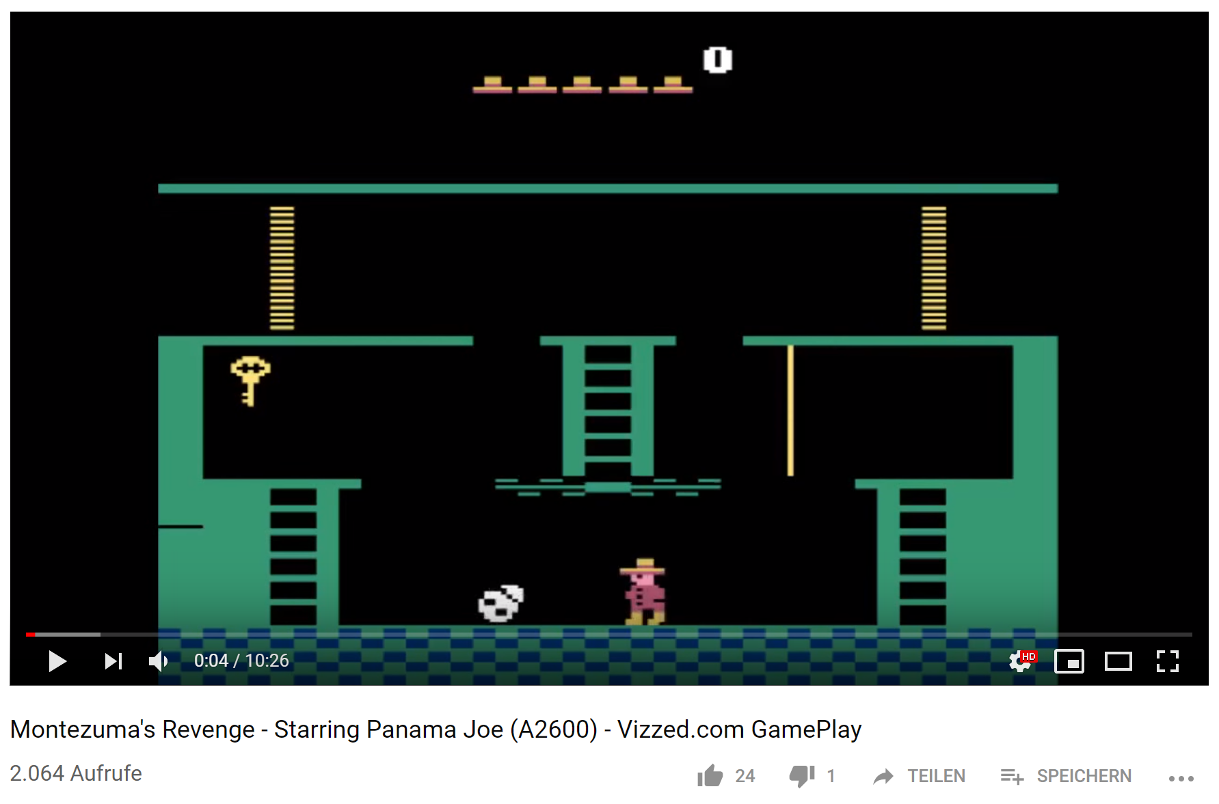
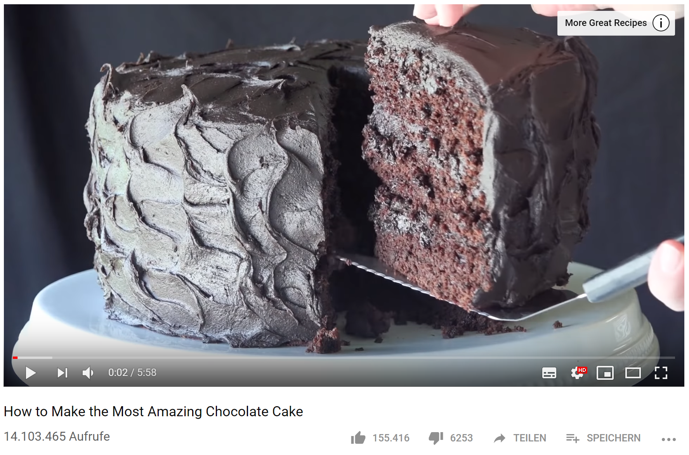
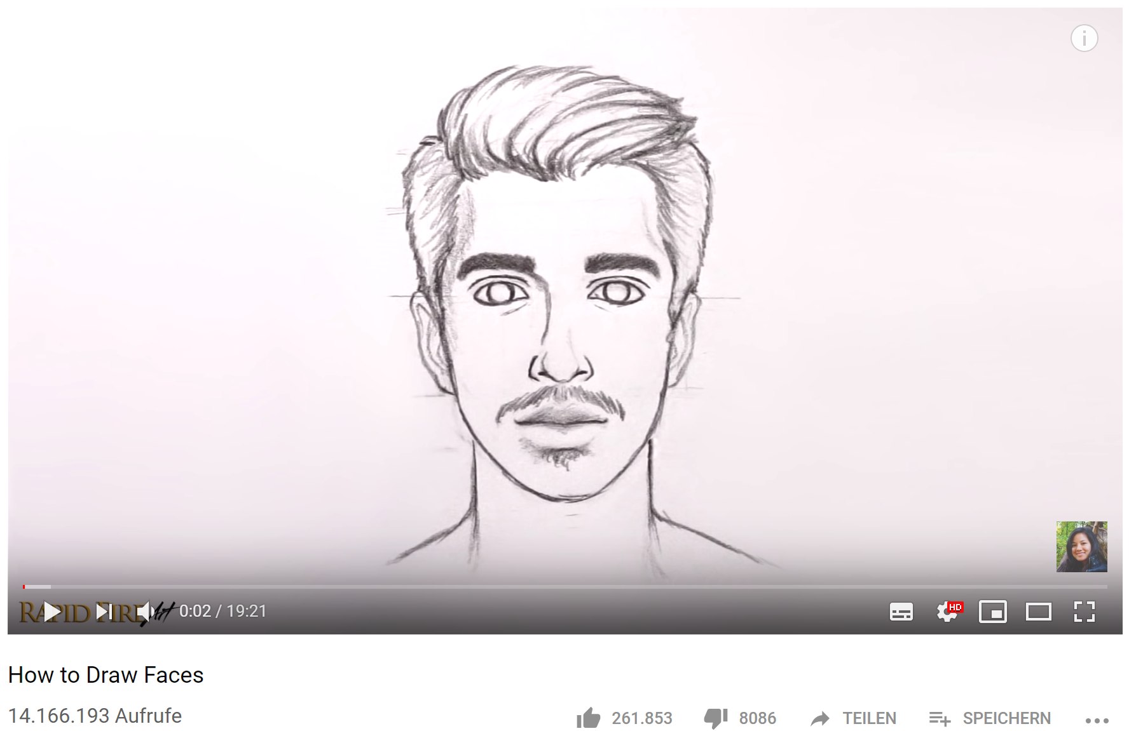
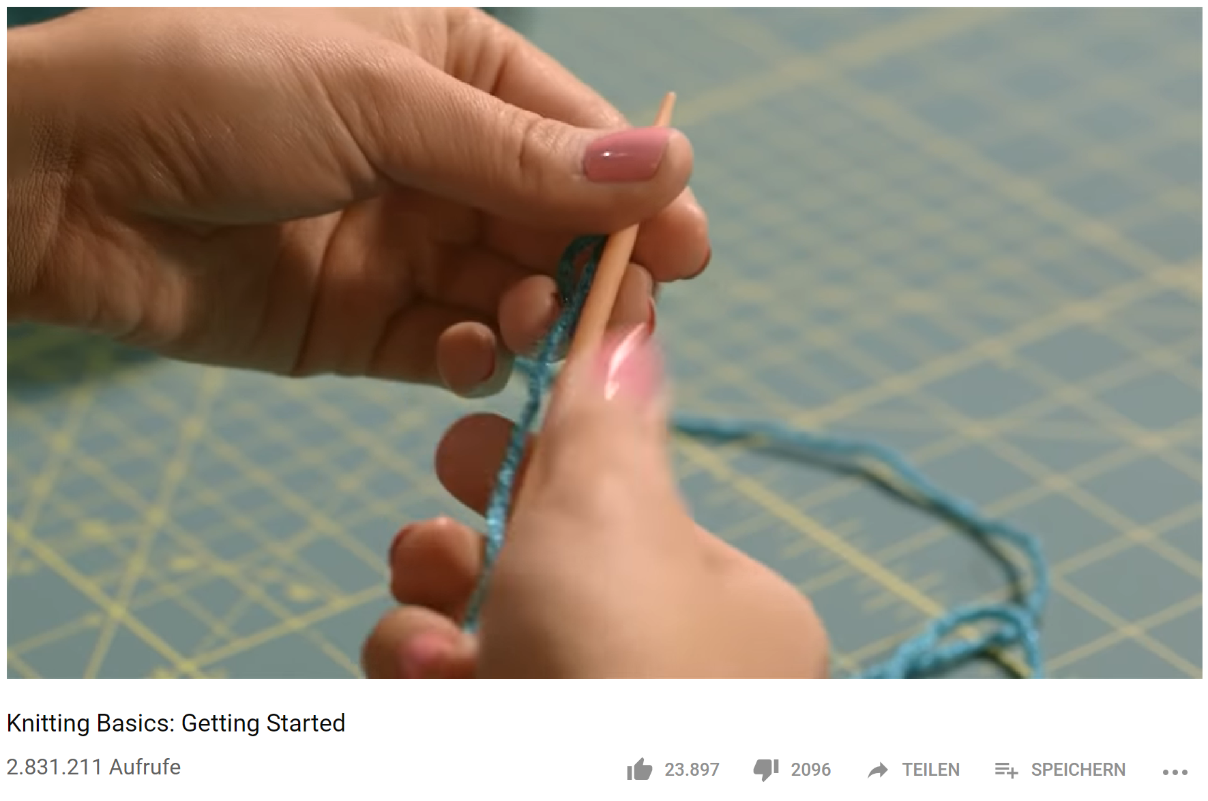
Humans learn from demonstrations.

Slide 9
https://www.youtube.com/watch?v=luDm-ieOOmA
Notes:
Zeigen, dass man das normalerweise nicht kann.

Slide 10
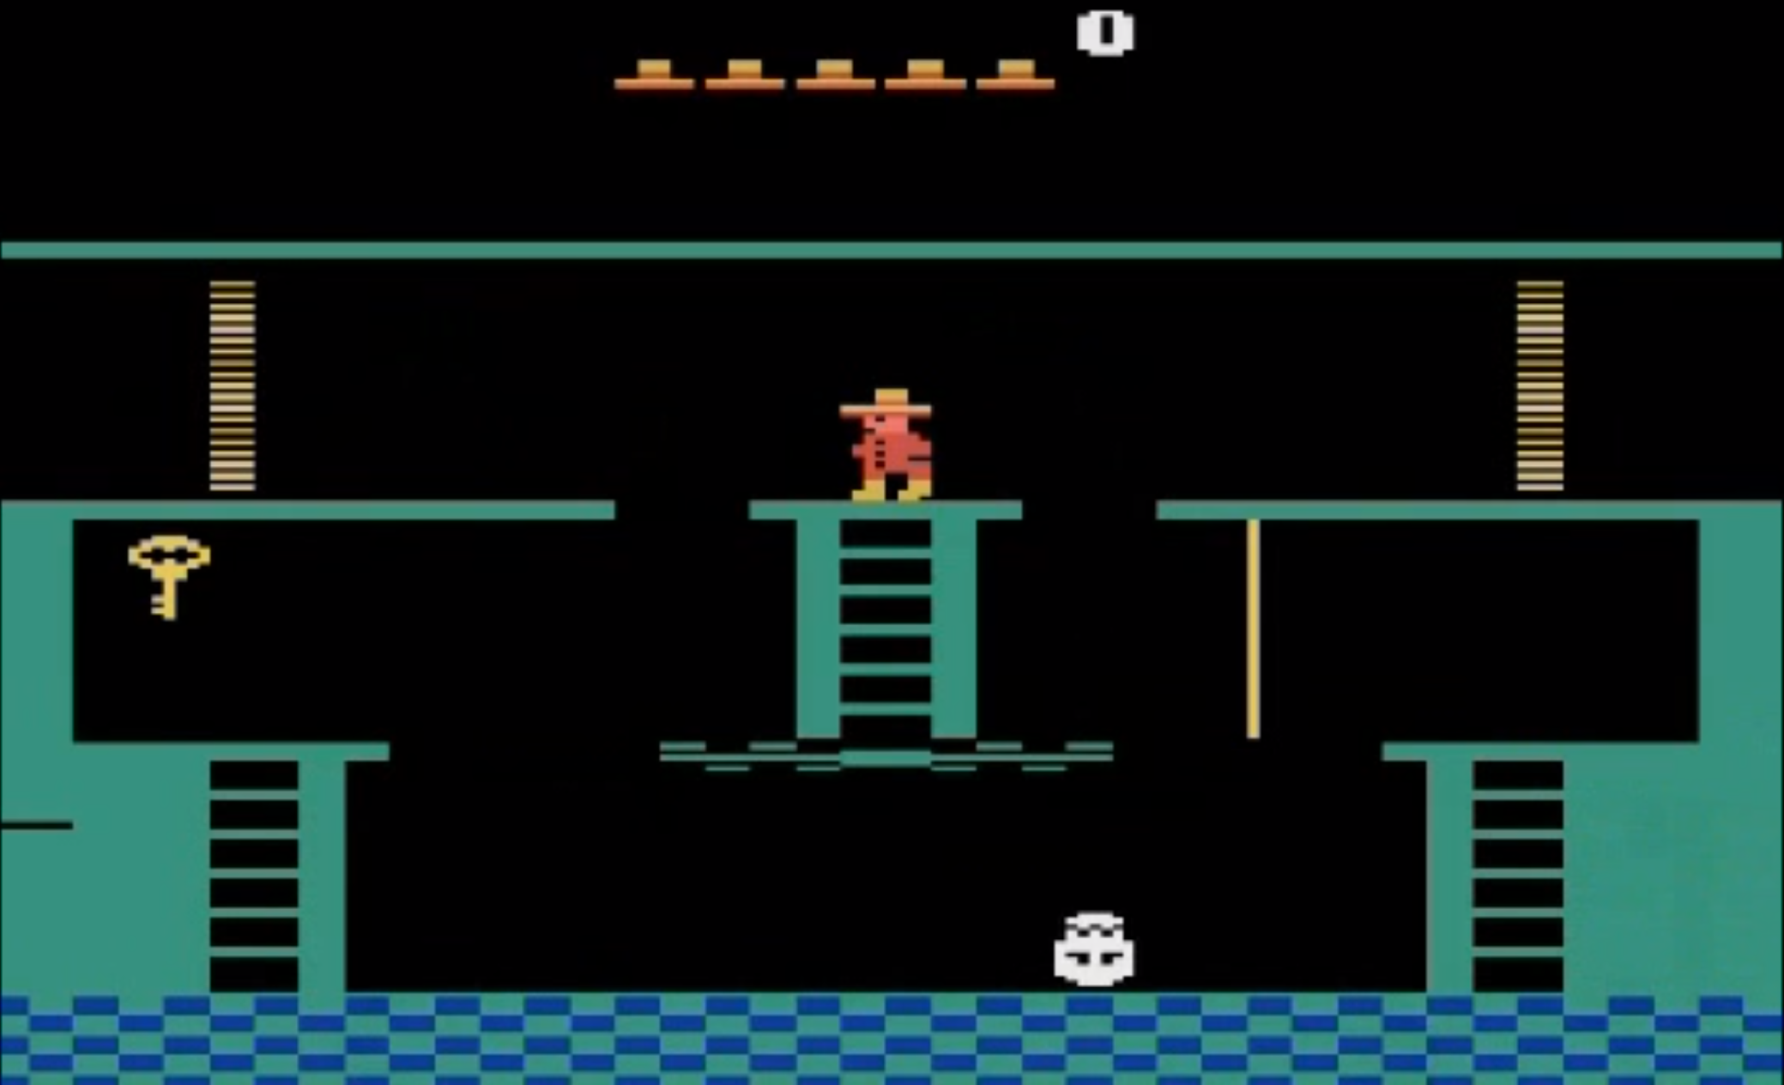
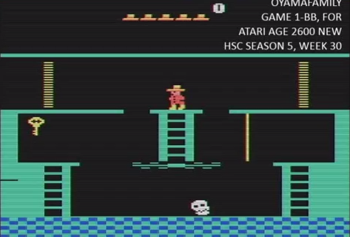
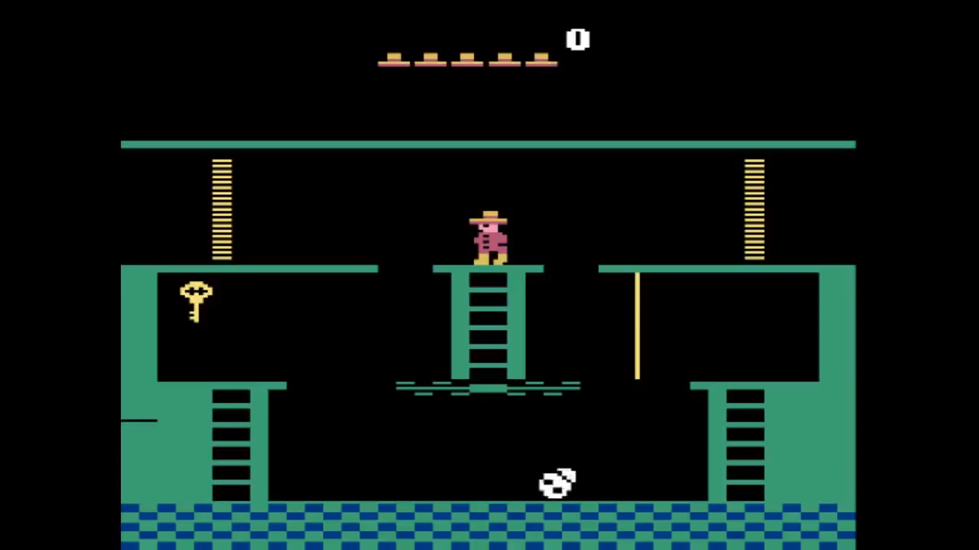
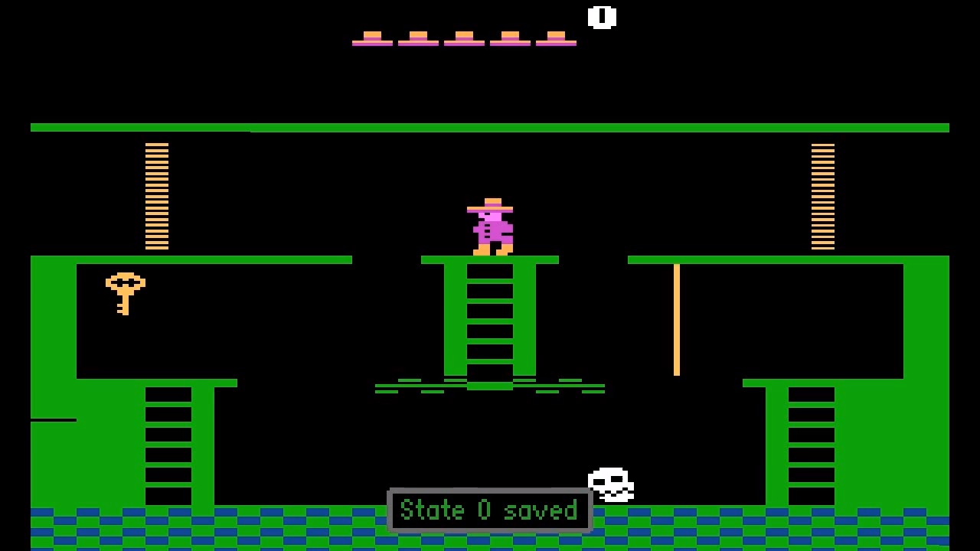
Domain Gap
learn a common representation

Slide 11
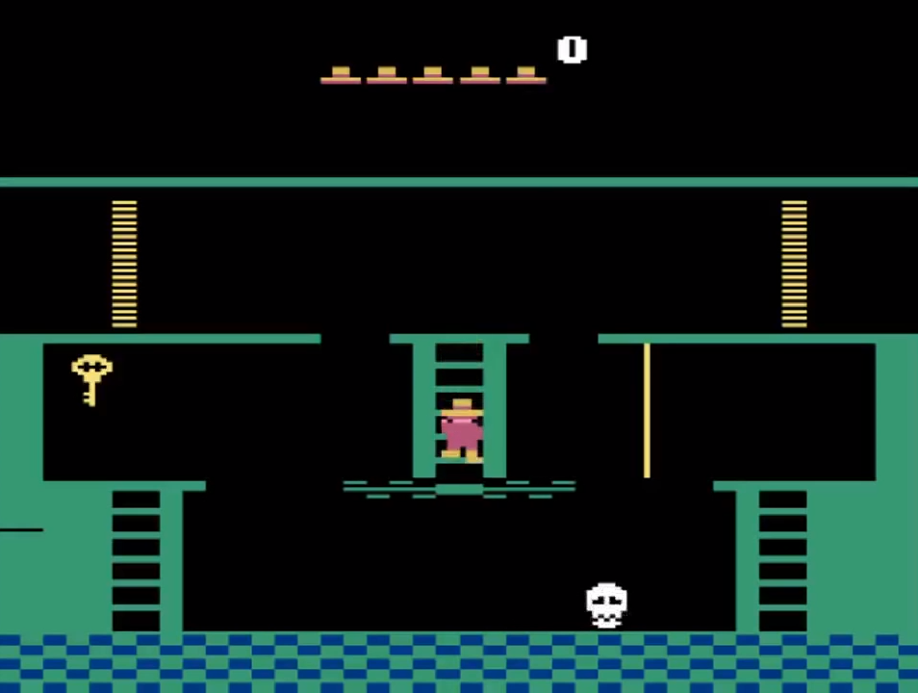
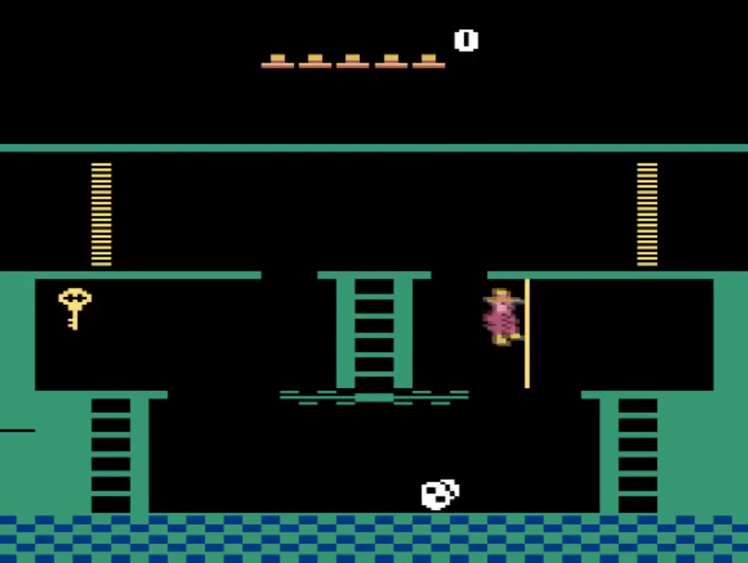
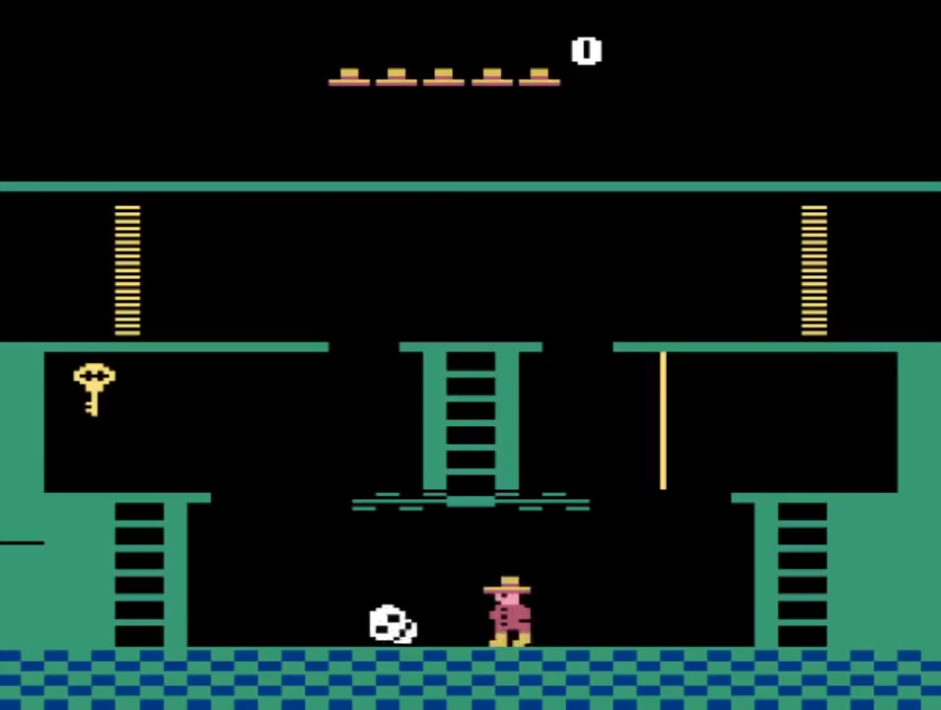
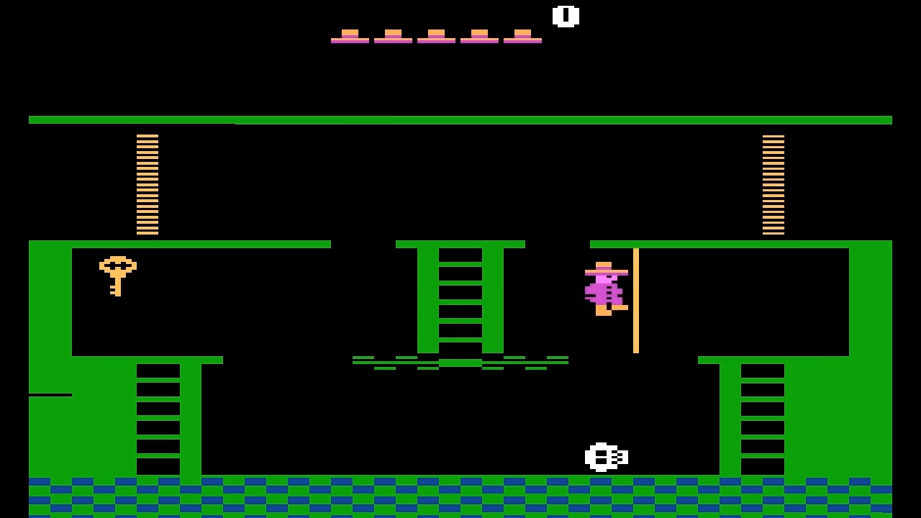
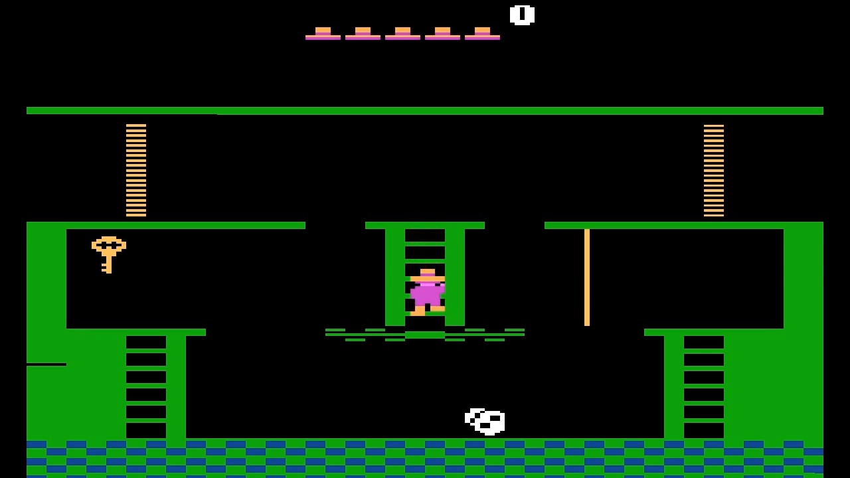
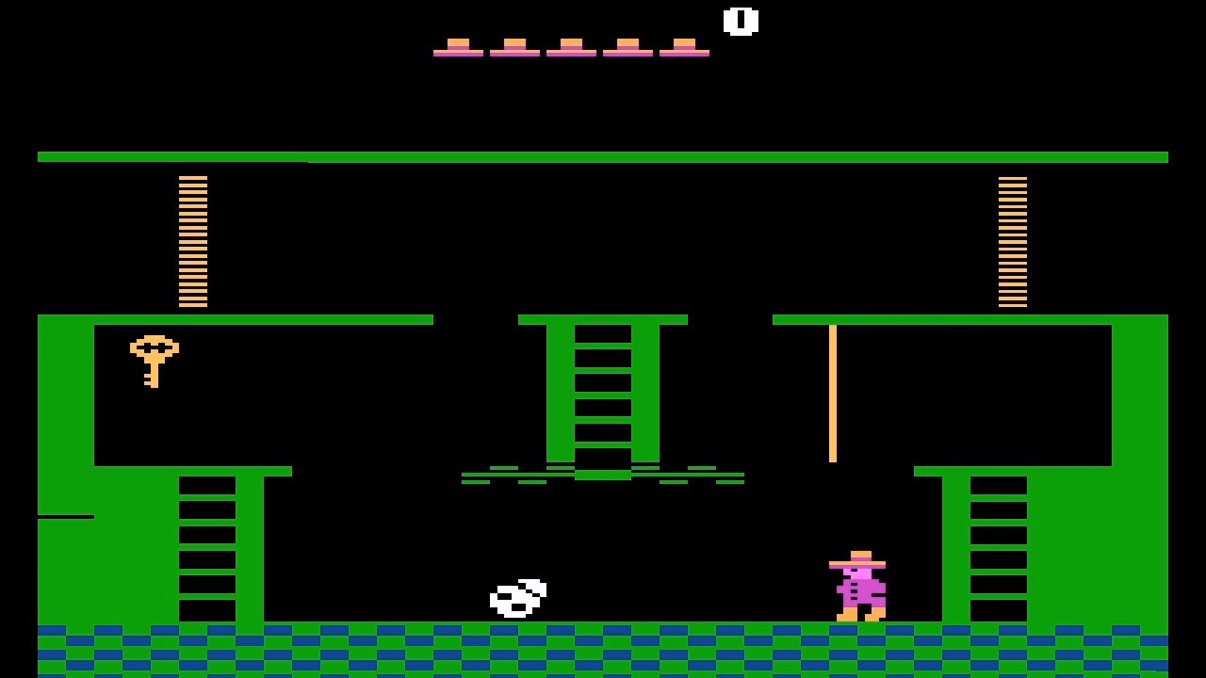
Pixel Embedding Space

Slide 12
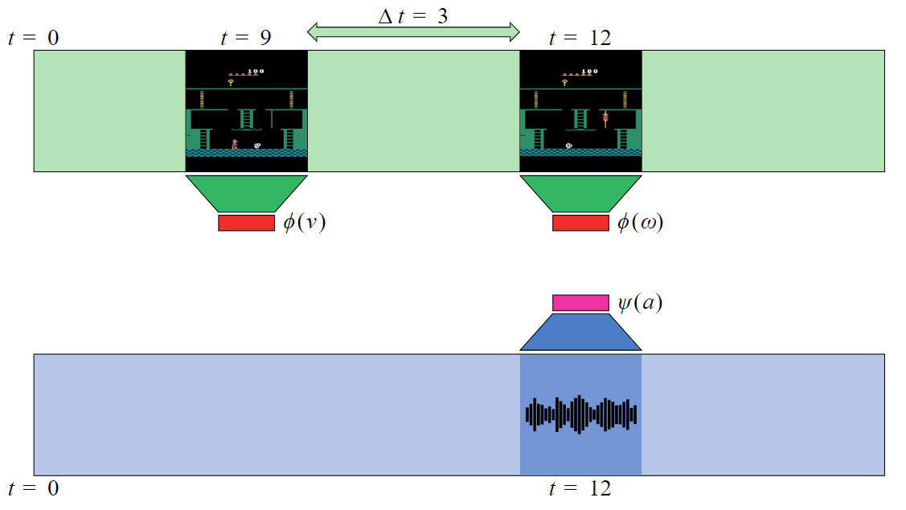
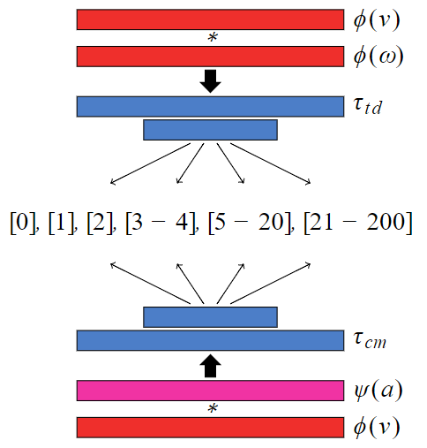
Closing the Domain Gap
audio embedding
classifiers
visual embedding

Slide 13
Temporal Distance Classification (TDC)
Cross-modal Temporal Distance Classification (CMC)

Slide 14
Temporal Distance Classification (TDC)
Cross-modal Temporal Distance Classification (CMC)

Slide 15
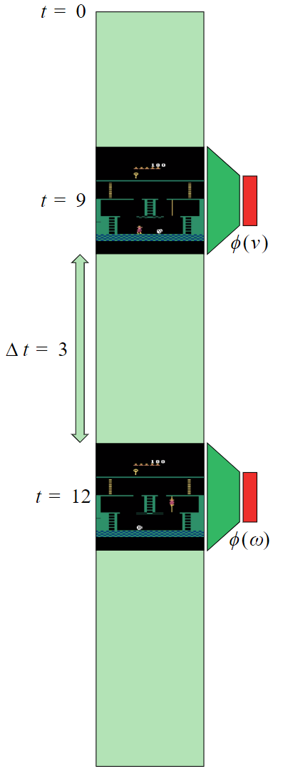
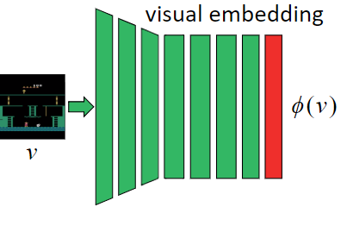
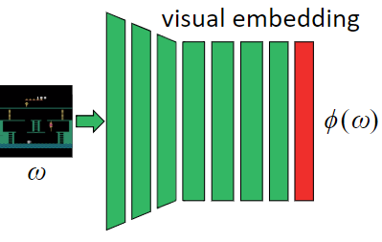
residual layers
fully connected layers
convolutional layers
classifier
Loss function
cross-entropy
classification loss

Slide 16
Temporal Distance Classification (TDC)
Cross-modal Temporal Distance Classification (CMC)

Slide 17
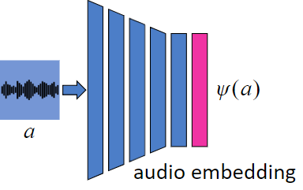
Loss function
cross-entropy
classification loss
convolutional layers
fully connected layers
classifier

Slide 18
Temporal Distance Classification (TDC)
Cross-modal Temporal Distance Classification (CMC)

Slide 19
Loss function:

Slide 20
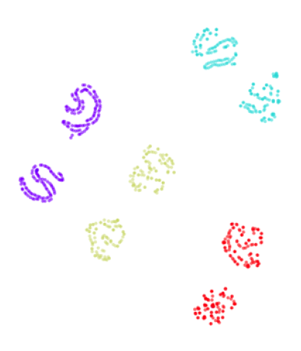
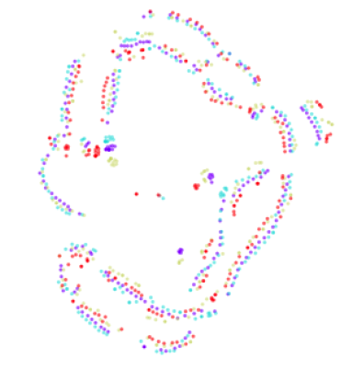
Embedding Space Evaluation
pixel
TDC+CMC

Slide 21
https://www.youtube.com/watch?v=RyxPAYhQ-Vo

Slide 22
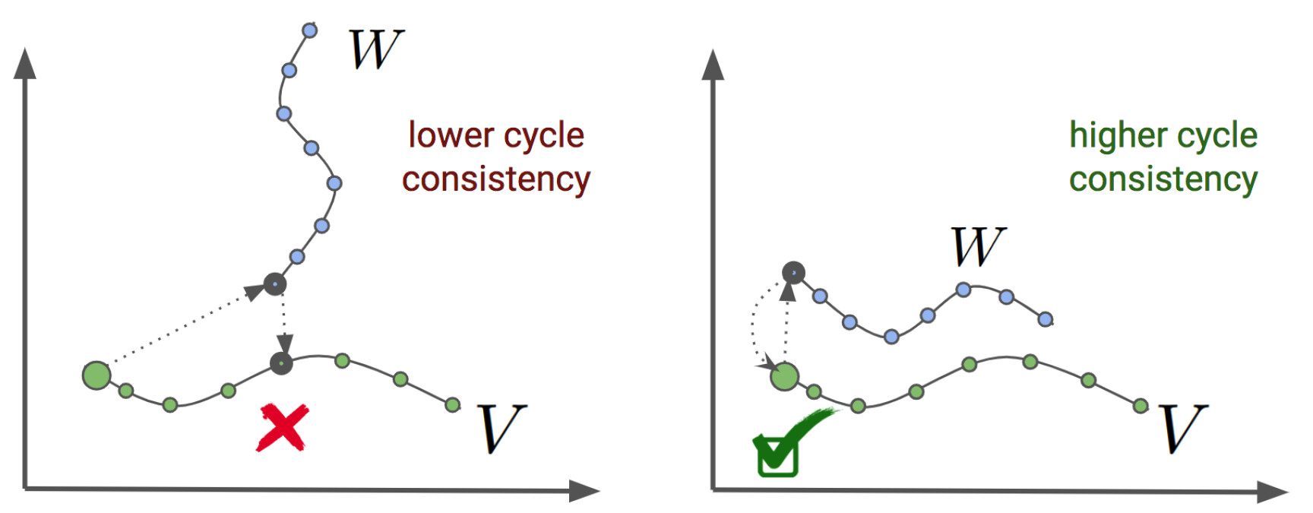
Cycle-Consistency

Slide 23
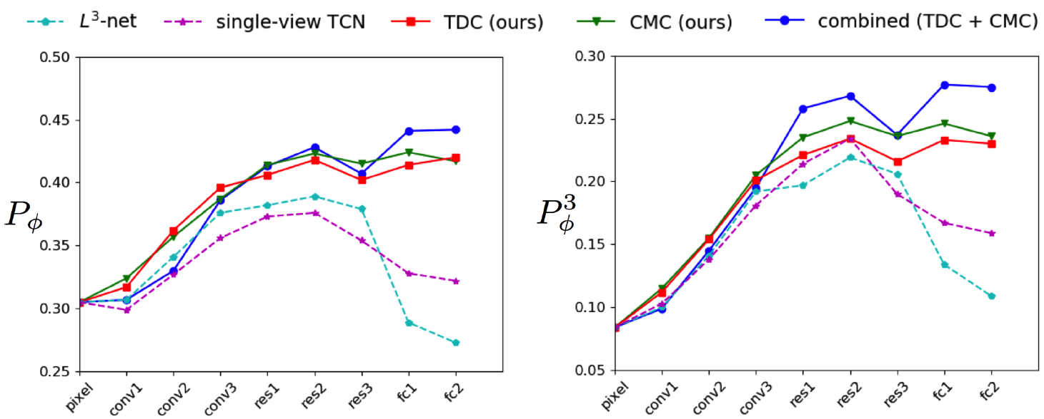
Cycle-Consistency

Slide 24
Neuron Activations
convolutional layer
final layer
final layer
neuron #46
focus on
the player
neuron #8
focus on the
enemies
neuron #39
focus on the
inventory
TDC (overall)
CMC (overall)
neuron #46
focus on
the player
neuron #8
focus on the
enemies
neuron #39
focus on the
inventory

Slide 25
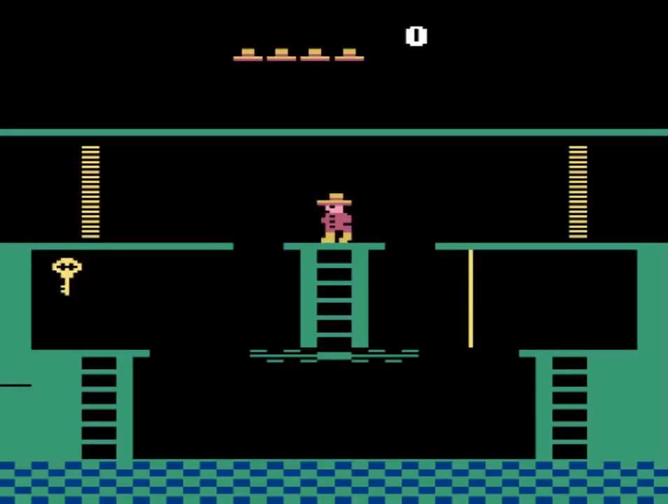
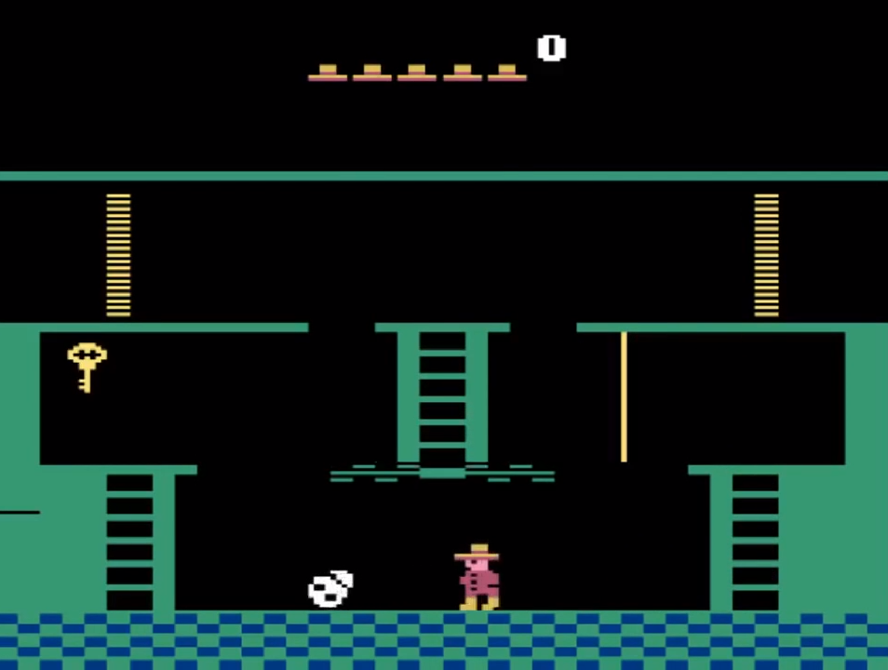
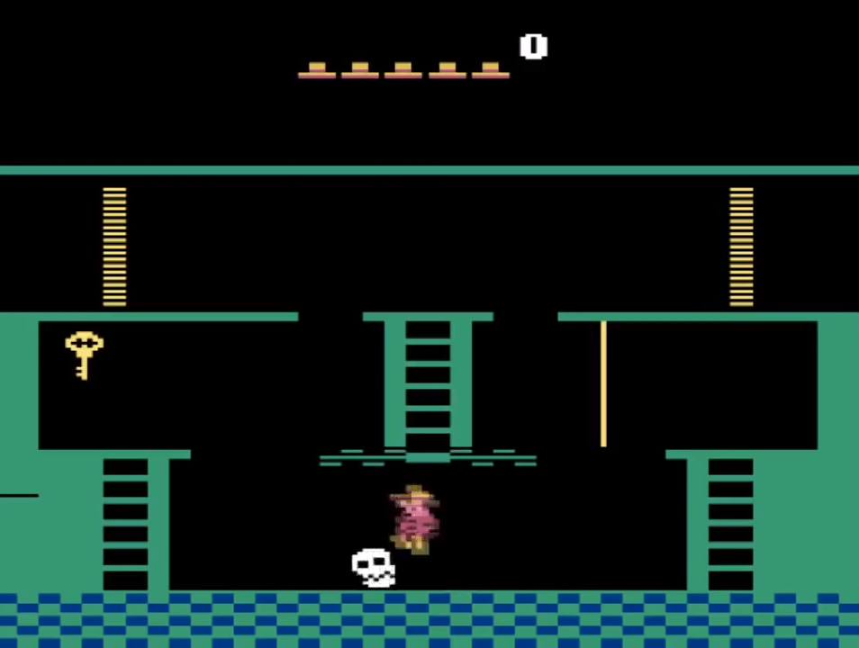
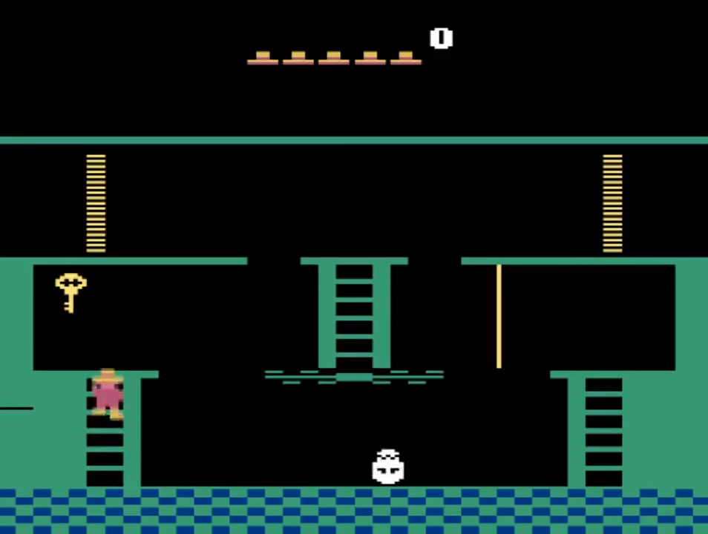
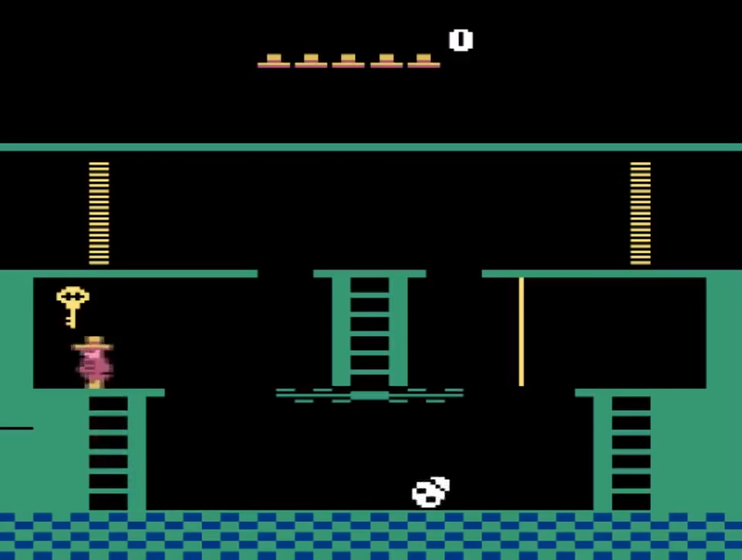
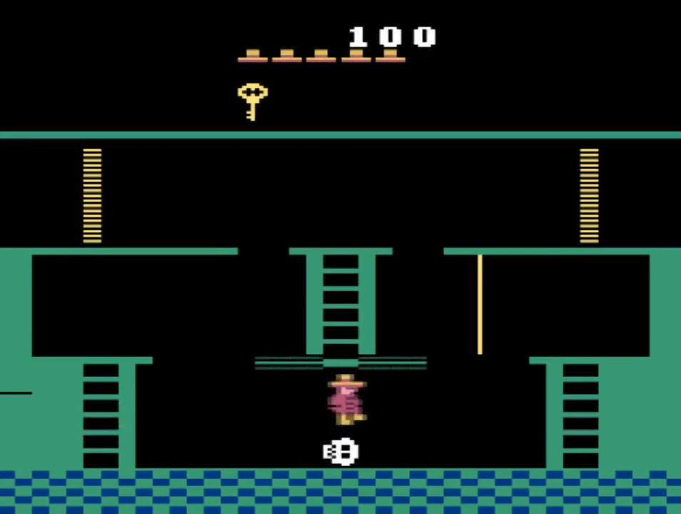
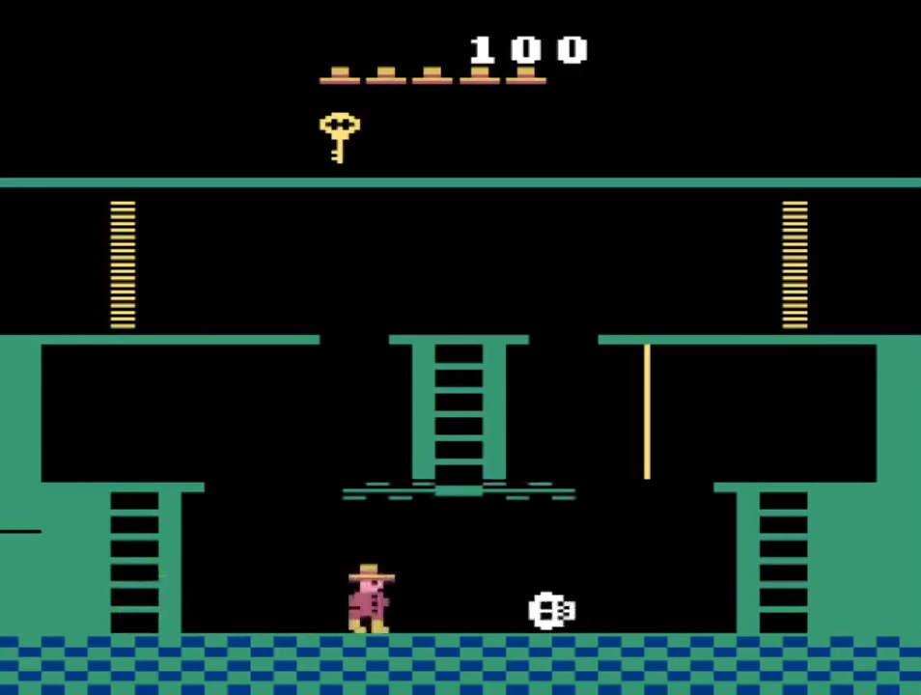
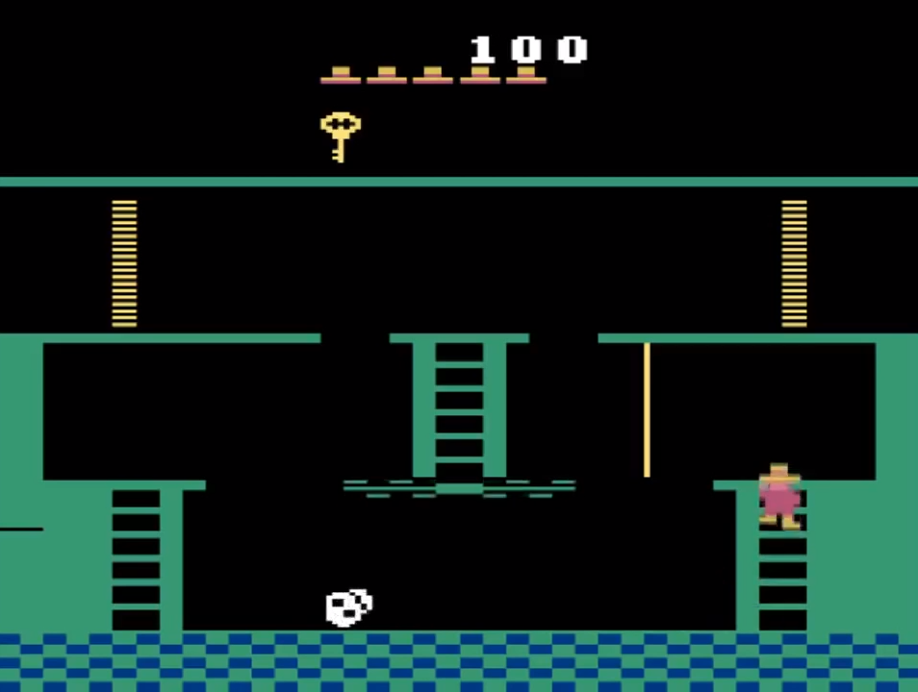
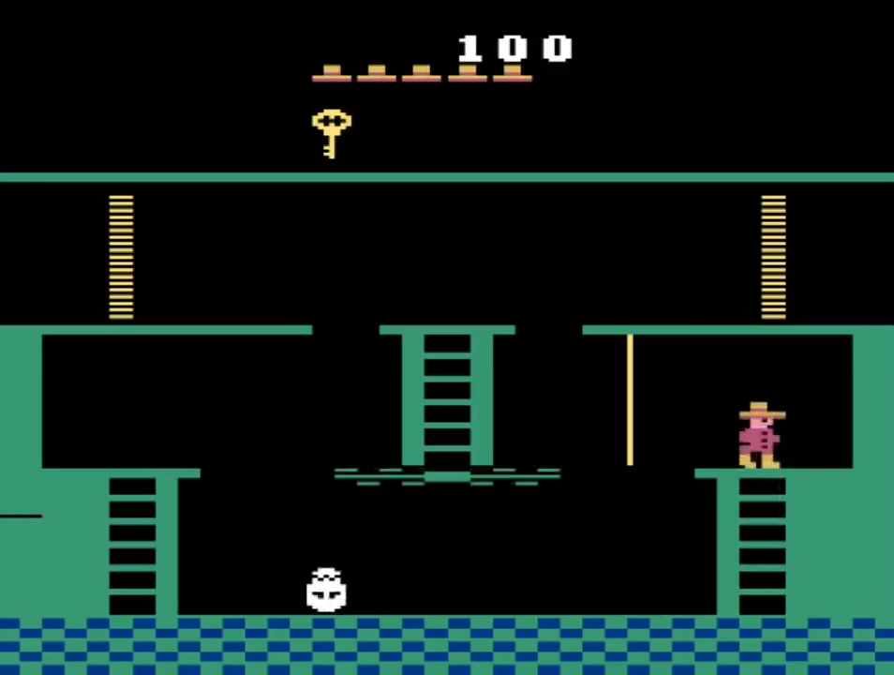
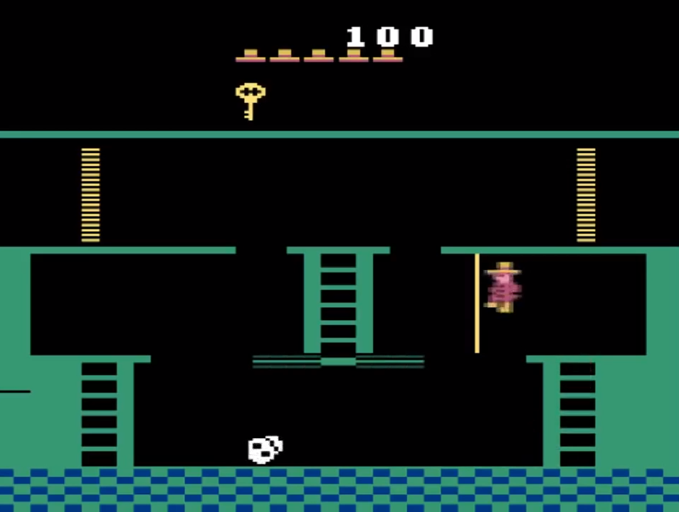
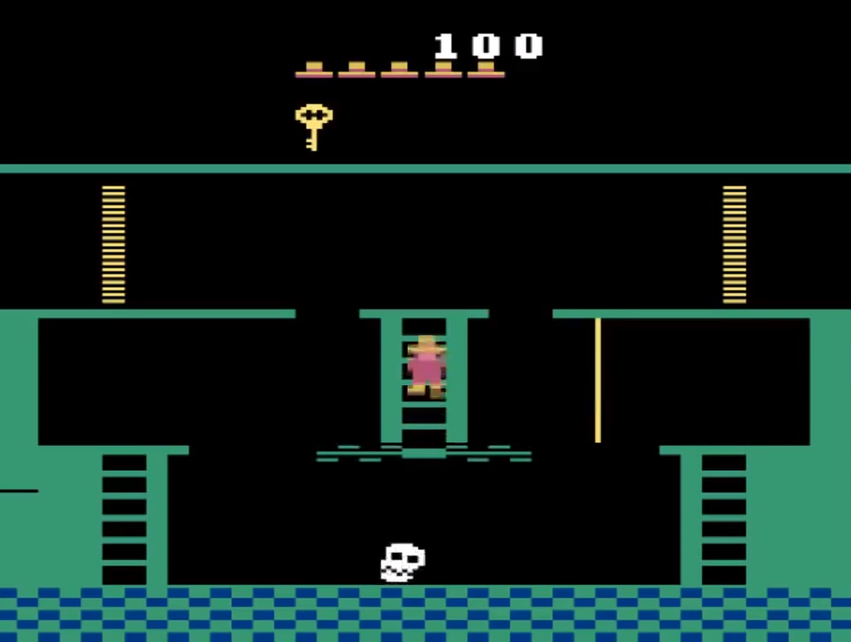
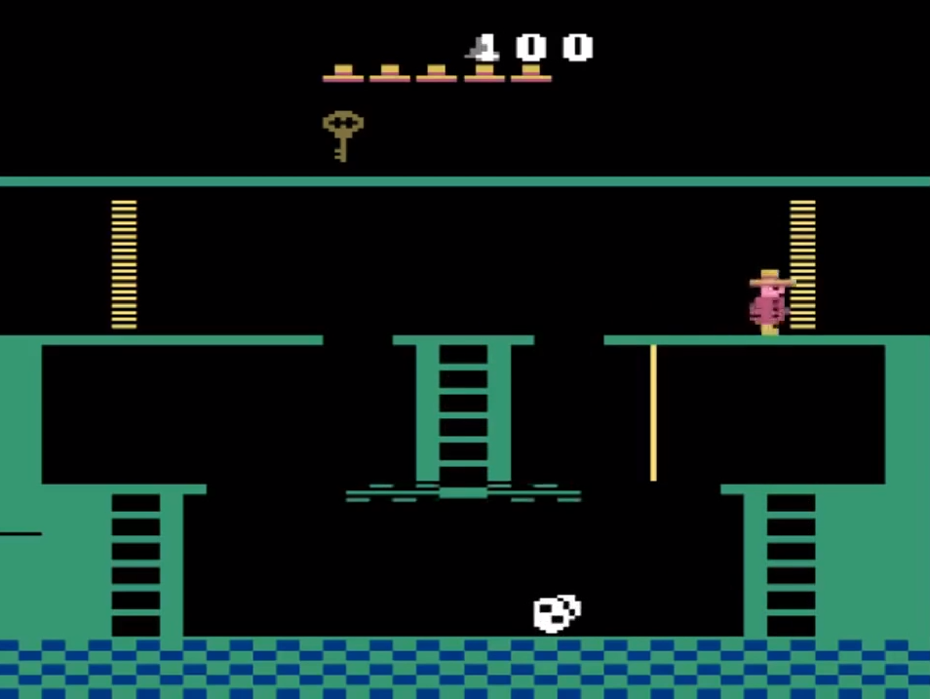
One-shot Imitation from YouTube

Slide 26
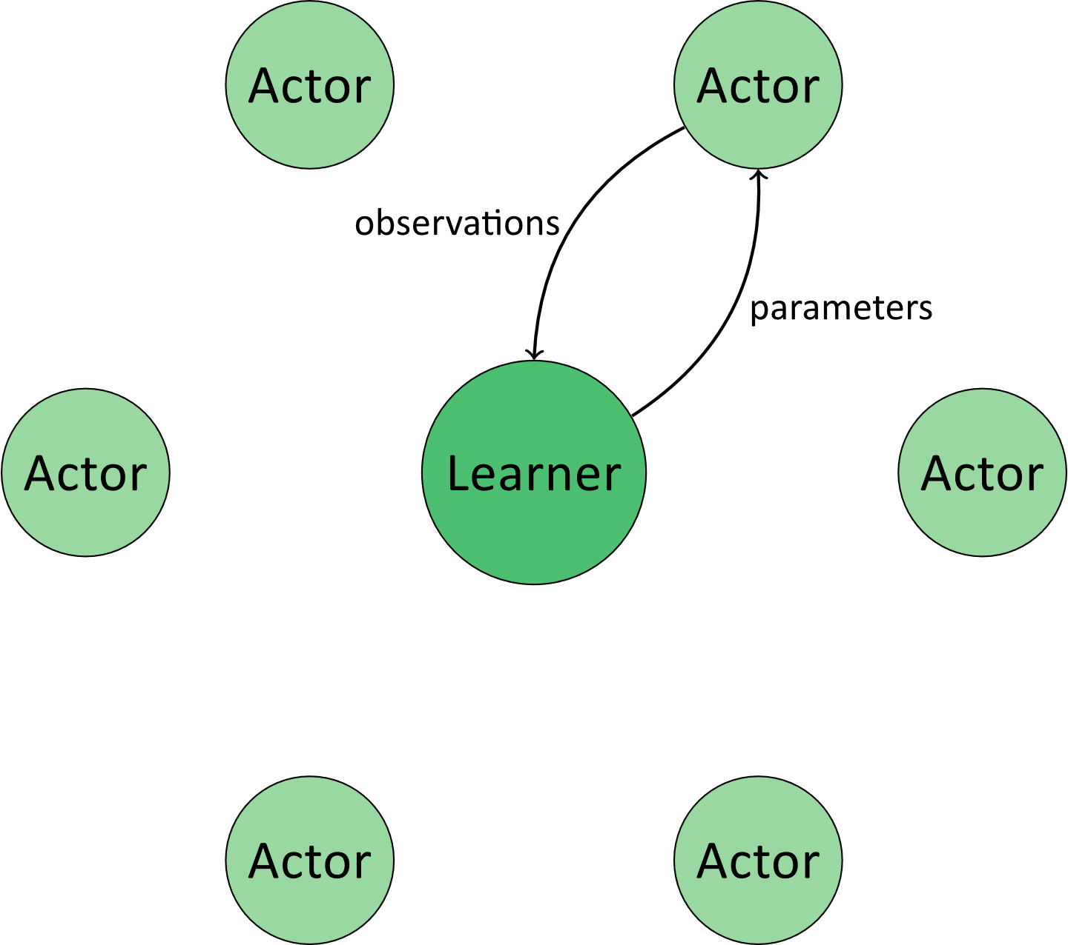
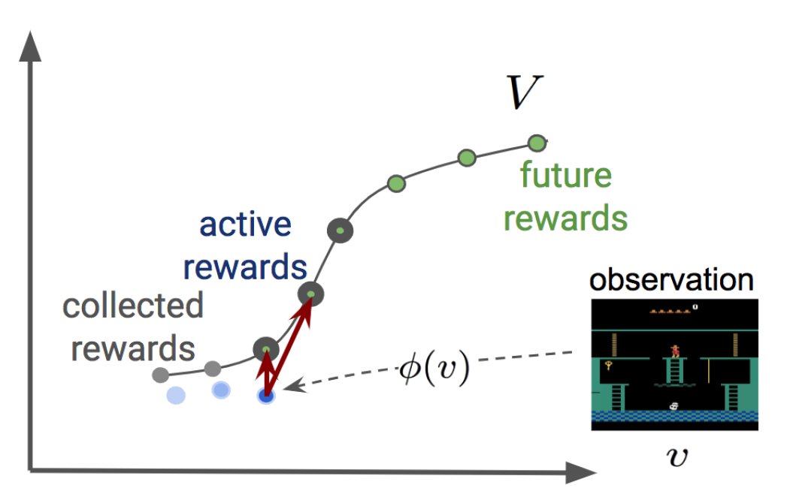
One-shot Imitation from YouTube

Slide 27
https://www.youtube.com/watch?v=DhUqfLjvONY

Slide 28
Solving Hard Exploration Games

Slide 29
Playing hard exploration games by watching YouTube
Kickstarting Deep Reinforcement Learning
kickstarting agents using previously trained experts

Slide 30
Kickstarting Reinforcement Learning Agents
student by Adrien Coquet from the Noun Project

Slide 31
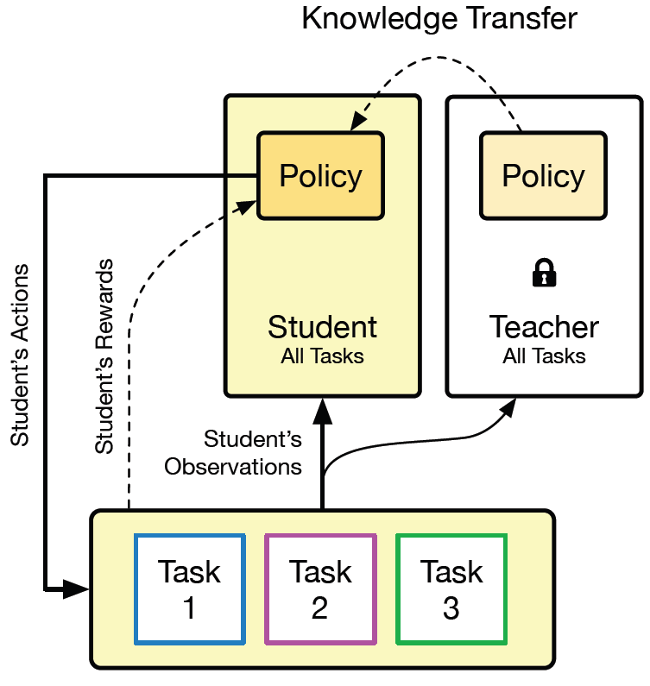
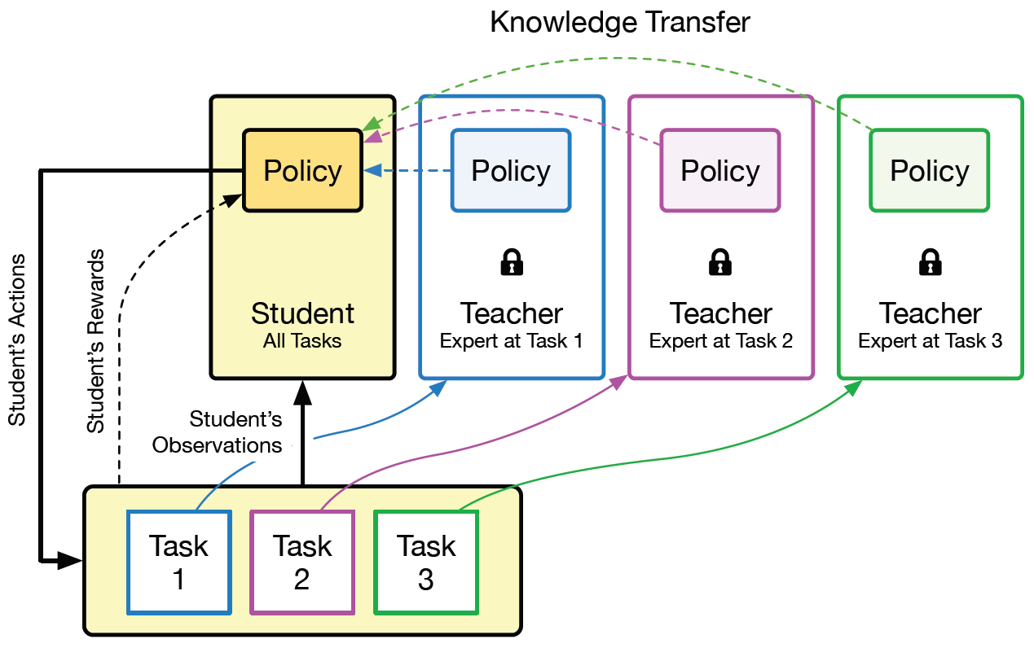
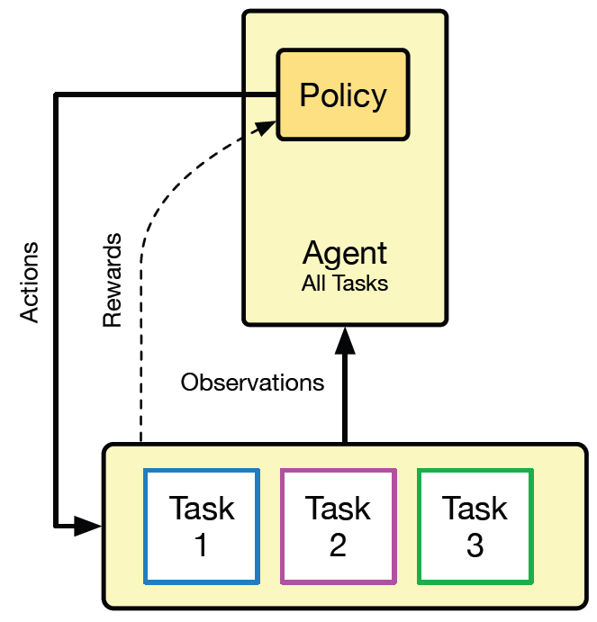
Kickstarting Reinforcement Learning Agents
standard multitask RL
single-teacher kickstarting
standard multitask RL
single-teacher kickstarting
multi-teacher kickstarting

Slide 32
Knowledge
Transfer
Kickstarting
Actor-Critic
policy distillation
IMPALA

Slide 33
Knowledge
Transfer
Kickstarting
Actor-Critic
policy distillation

Slide 34
Policy Distillation
RL loss
encourages maximization of own rewards
distillation loss
encourages student to match the teachers policy
RL loss
encourages maximization of own rewards
student by Adrien Coquet from the Noun Project

Slide 35
Knowledge
Transfer
Kickstarting
Actor-Critic
IMPALA

Slide 36
Actor-Critic Reinforcement Learning

Slide 37
Population Based Training (PBT)
performance
hyperparameters
model
exploit
explore

Slide 38
Analysis
Kickstarting With
a Single Teacher
Kickstarting With
Multiple Teachers

Slide 39
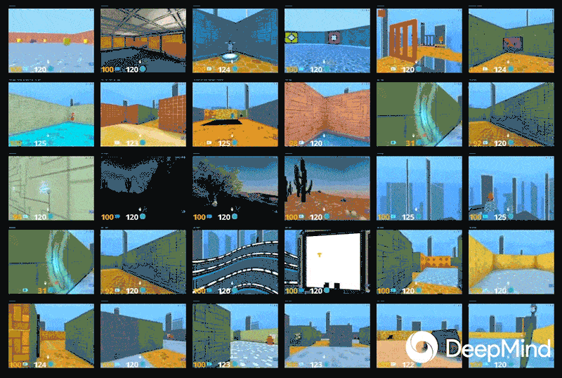
DMLab-30
https://deepmind.com/blog/impala-scalable-distributed-deeprl-dmlab-30/#gif-163

Slide 40
Kickstarting With
a Single Teacher
Kickstarting With
Multiple Teachers

Slide 41
Kickstarting With a Single Small Teacher

Slide 42
Distillation Weight Scheduling Strategies

Slide 43
Kickstarting With
a Single Teacher
Kickstarting With
Multiple Teachers

Slide 44
Kickstarting With Multiple Teachers

Slide 45
Kickstarting With PBT Variants vs. Distillation

Slide 46
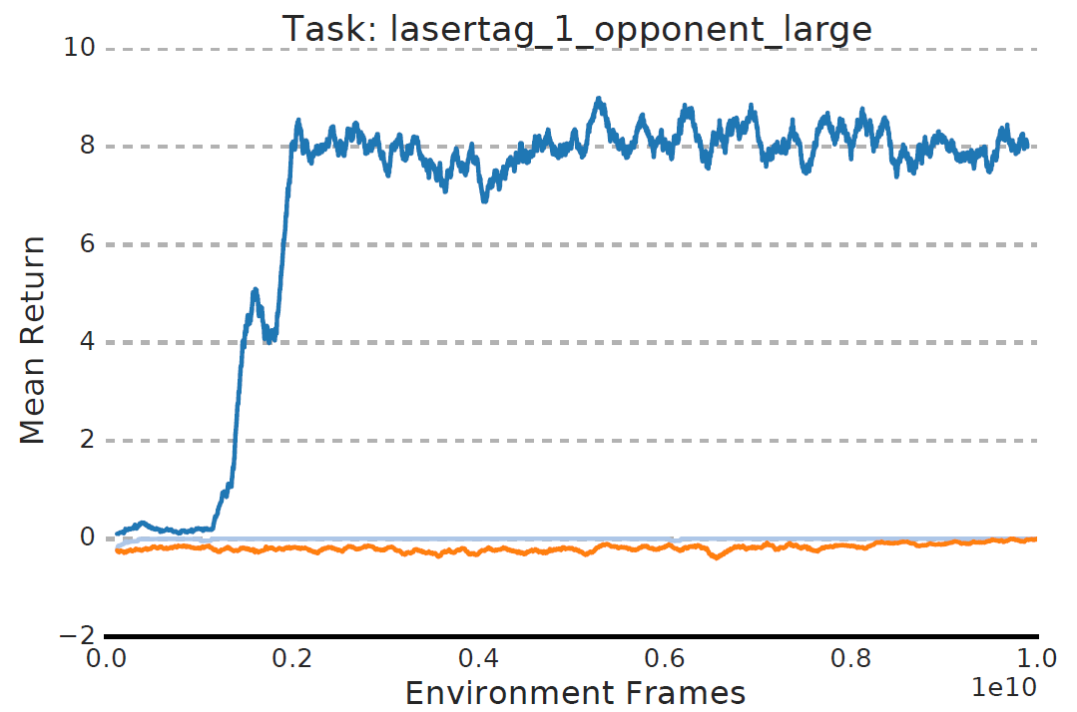
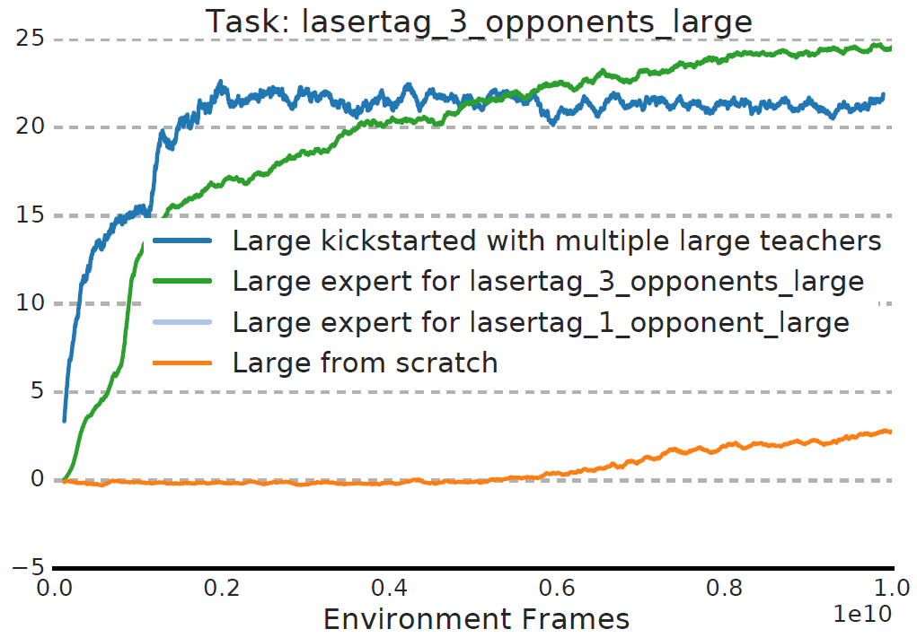
Per Task Performance
Lasertag with One Opponent
Lasertag with Three Opponents

Slide 47
Per Task Performance
Explore Goal Locations

Slide 48
Playing hard exploration games by watching YouTube
Kickstarting Deep Reinforcement Learning
learning of common representation
exceed human-level performance in Montezuma’s Revenge, Private Eye and Pitfall
reduced environment interactions required for learning
student can exceed teacher performance
no general purpose solution
success limited to knowledge obtained from demonstration
limited to the setting where pre-trained experts are readily available
vague definition of experts

Slide 49
References
Andrychowicz, M., Wolski, F., Ray, A., Schneider, J., Fong, R., Welinder, P., McGrew, B., Tobin, J., Abbeel, P., & Zaremba, W. (2017). Hindsight Experience Replay. NIPS.
Aytar, Y., Pfaff, T., Budden, D., Paine, T.L., Wang, Z., & Freitas, N.D. (2018). Playing hard exploration games by watching YouTube. NeurIPS.
Ecoffet, A., Huizinga, J., Lehman, J., Stanley, K.O., & Clune, J. (2019). Go-Explore: a New Approach for Hard-Exploration Problems. CoRR, abs/1901.10995.
Espeholt, L., Soyer, H., Munos, R., Simonyan, K., Mnih, V., Ward, T., Doron, Y., Firoiu, V., Harley, T., Dunning, I., Legg, S., & Kavukcuoglu, K. (2018). IMPALA: Scalable Distributed Deep-RL with Importance Weighted Actor-Learner Architectures. ICML.
Mnih, V., Badia, A.P., Mirza, M., Graves, A., Lillicrap, T.P., Harley, T., Silver, D., & Kavukcuoglu, K. (2016). Asynchronous Methods for Deep Reinforcement Learning. ICML.
Schmitt, S., Hudson, J.J., Zídek, A., Osindero, S., Doersch, C., Czarnecki, W., Leibo, J.Z., Küttler, H., Zisserman, A., Simonyan, K., & Eslami, S.M. (2018). Kickstarting Deep Reinforcement Learning. CoRR, abs/1803.03835.

Slide 50
Video References
[AmandaRachLee]. (2017, June 14). How To: Calligraphy & Hand Lettering for Beginners! Tutorial + Tips! [Video File]. Retrieved from https://www.youtube.com/watch?v=sBoVGqiSzr4
[Hobby Lobby]. (2014, September 23). Knitting Basics: Getting Started [Video File]. Retrieved from https://www.youtube.com/watch?v=hM5M2Fu0RtY
[marcelo carvalho]. (2014, May 4). Sessão Nostalgia apresenta - Grandes clássicos do ATARI - "MONTEZUMA'S REVENGE". Retrieved from https://www.youtube.com/watch?v=pF6xCZA72o0
[petsasjim1]. (2017, March 31). ATARI 2600 Montezuma's Revenge Trainer Montezuma's Revenge Hack 2006 Steve Engelhardt [Video File]. Retrieved from https://www.youtube.com/watch?v=2AYaxTiWKoY
[pigme]. (2016, May 29). How to Front Flip Tutorial | Only 5 Minutes to Learn [Video File]. Retrieved from https://www.youtube.com/watch?v=_Z7ekwI7oMI
[RapidFireArt]. (2017, October 24). How to Draw Faces [Video File]. Retrieved from https://www.youtube.com/watch?v=iMEBSQJYaAY
[The Stay At Home Chef]. (2016, June 8). How to Make the Most Amazing Chocolate Cake [Video File]. Retrieved from https://www.youtube.com/watch?v=dsJtgmAhFF4
[Tobias Pfaff]. (2018, May 29). Comparison snippet - Montezuma's Revenge [Video File]. Retrieved from https://www.youtube.com/watch?v=DhUqfLjvONY
[Tobias Pfaff]. (2018, October 13). Learnt agent - Montezuma's Revenge (updated) [Video File]. Retrieved from https://www.youtube.com/watch?v=luDm-ieOOmA
[Tobias Pfaff]. (2018, October 13). Learnt agent - Pitfall! (updated) [Video File]. Retrieved from https://www.youtube.com/watch?v=3XMJR7z2KMc
[Tobias Pfaff]. (2018, May 29). Learnt agent - Private Eye [Video File]. Retrieved from https://www.youtube.com/watch?v=I5itifmdrEo
[Tobias Pfaff]. (2018, May 29). t-SNE plot of our TDC+CMC embedding [Video File]. Retrieved from https://www.youtube.com/watch?v=RyxPAYhQ-Vo
[Were1974]. (2013, May 11). Montezumas Revenge 242900pts for 2600 NEW HSC S5 Week 30 [Video File]. Retrieved from https://www.youtube.com/watch?v=6zXXZvVvTFs
[Vizzed Gameplay Videos]. (2015, April 2). Montezuma's Revenge - Starring Panama Joe (A2600) - Vizzed.com GamePlay [Video File]. Retrieved from https://www.youtube.com/watch?v=SuZVyOlgVek
[Wilson Oyama]. (2016, August 14). Montezuma's Revenge (ADDON! ATARI_2600) [Video File]. Retrieved from https://www.youtube.com/watch?v=sYbBgkP9aMo

Slide 51
Learning from Artificial Demonstrations
Lioba Heimbach
Seminar in Deep Reinforcement Learning
ETH Zürich
Mar 26 2019
student by Adrien Coquet from the Noun Project

Slide 52
https://www.youtube.com/watch?v=I5itifmdrEo

Slide 53
https://www.youtube.com/watch?v=3XMJR7z2KMc

Slide 54
IMPALA
Extension of the actor-critic formulation to a large-scale setting with distributed worker machines.
student policy
value function target
importance sampling weights
reward
value approximation

