Slide 1
Learning in sparse environments
Andrychowicz, Marcin, et al. "Hindsight experience replay." Advances in Neural Information Processing Systems. 2017.
Gangwani, Tanmay, Qiang Liu, and Jian Peng. "Learning self-imitating diverse policies." arXiv preprint arXiv:1805.10309(2018).
Presentation by Amray Schwabe
Notes:
Welcome to presentation of my bachelors thesis. The topic of my thesis was “emergency evacuation in a virtual reality environment”. But what was it really about? I will explain this to you by guiding you through an example. Imagine you are on vacation, in a nice hotel an enjoying your time. But suddenly, in the middle of the night, you wake up to the sound of a fire alarm. After a few seconds of confusion you get up, go to the door of your room, peek outside and see this:

Slide 2
Problem
x
x
x
sparse rewards
no demonstrations
multiple goals

Slide 3
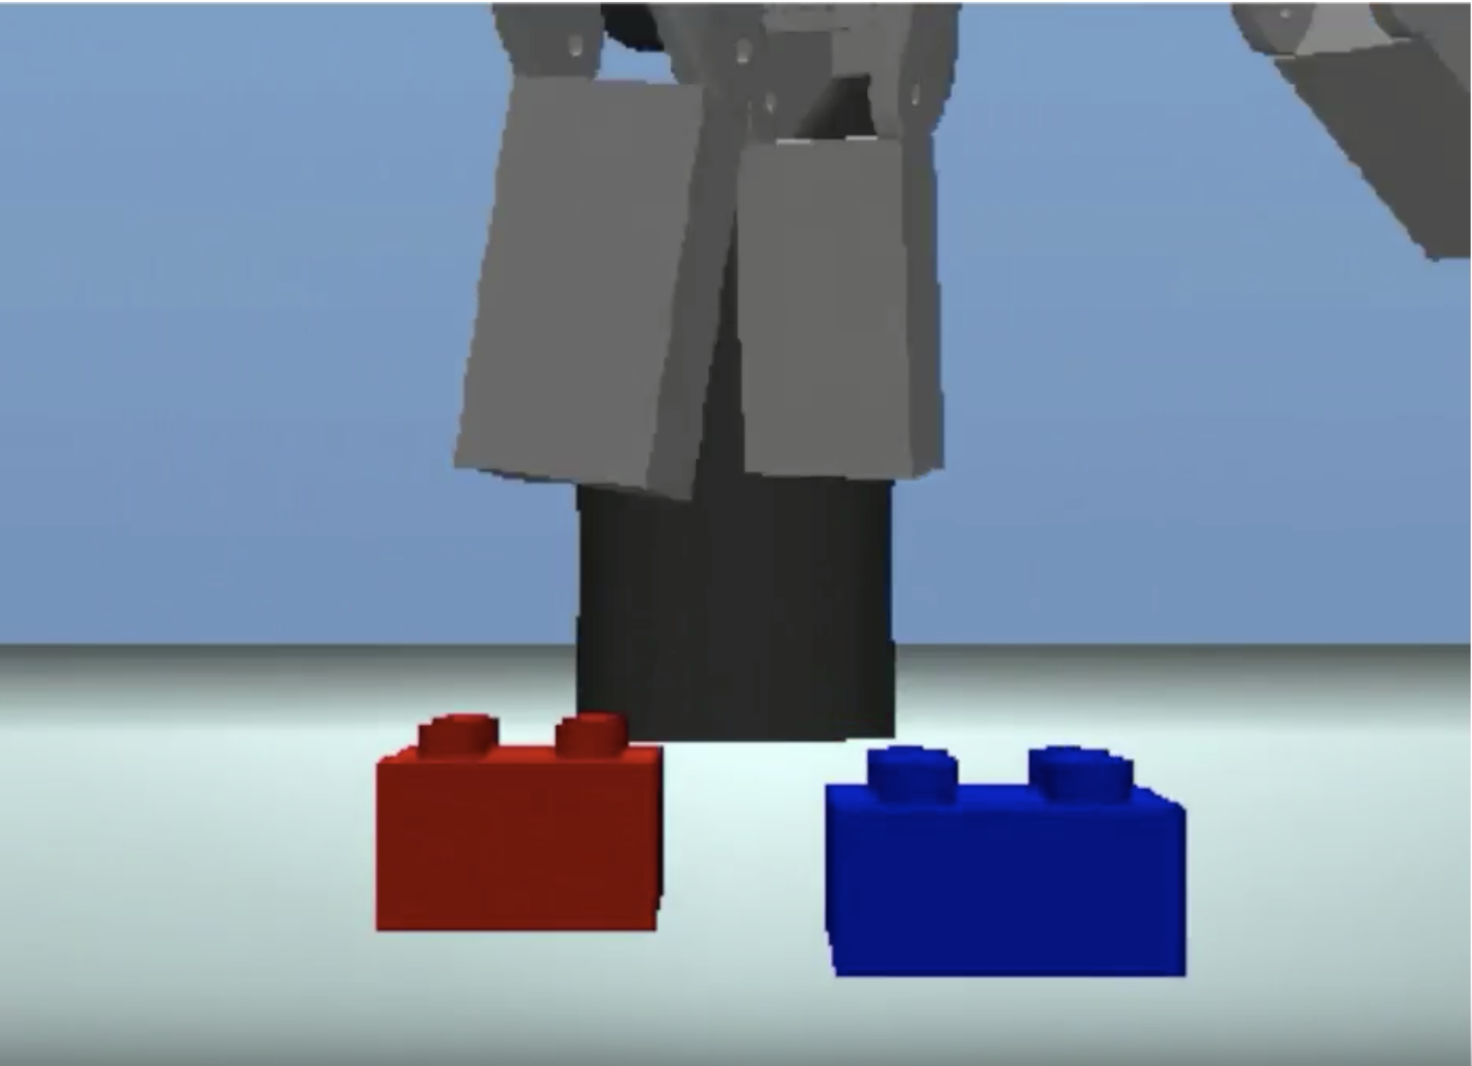
A first approach

Slide 4
Result

Slide 5
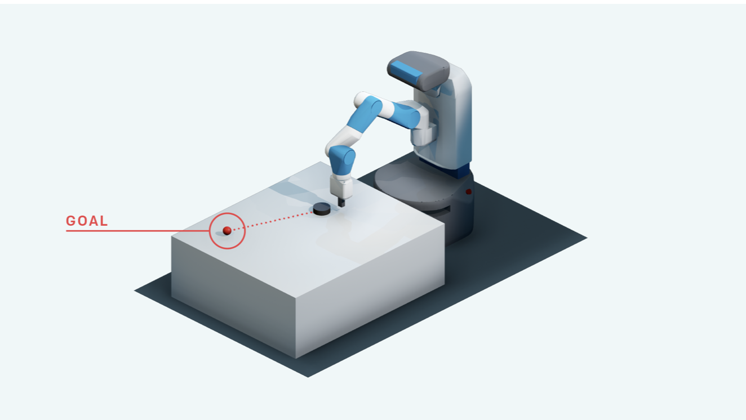
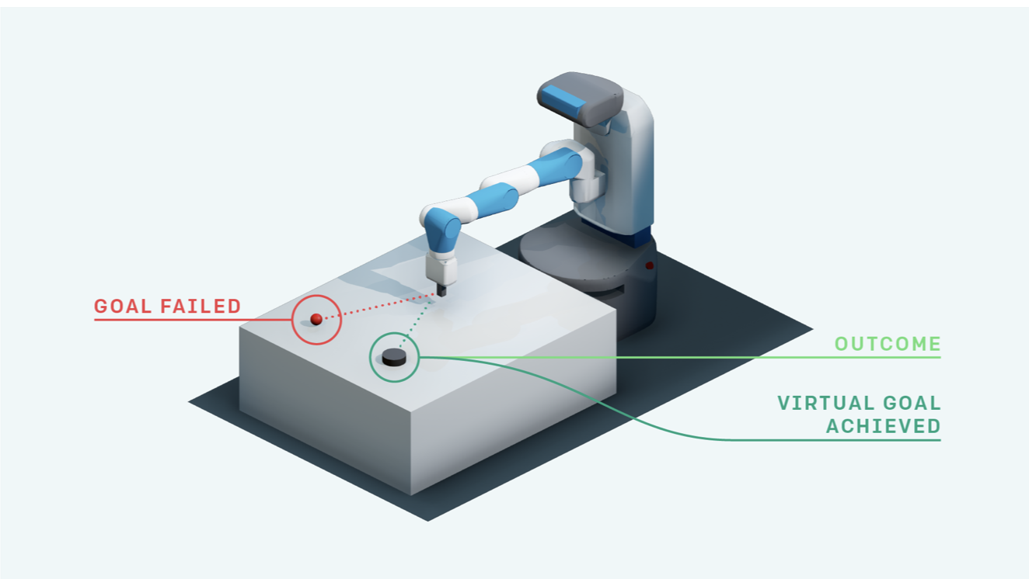
Hindsight Experience Replay

Slide 6
DQN Algorithm
initialize replay buffer R
initialize action value function $Q$ and target network $\hat{Q}$
for episode = 1 to M do
observe initial state $s_{0}$
for t = 0 to T-1 do {
select an action a, execute it and observe reward r and next state $s_{t+1}$
store transition ($s_{t},a_{t},r_{t},s_{t+1}$) in R
}
for t = 0 to N do {
sample minibatch of transitions ($s_{j},a_{j},r_{j},s_{j+1}$) from R
perform one step of optimization
every C steps set $\hat{Q}$ = $Q$
}
}

Slide 7
DQN + HER Algorithm
initialize replay buffer R
initialize action value function Q and target network $\hat{Q}$
for episode = 1 to M do
sample goal g and observe initial state $s_{0}$
for t = 0 to T-1 do {
select an action a, execute it and observe reward r and next state $s_{t+1}$
}
for t = 0 to T-1 do {
store transition ($s_{t},a_{t},r_{t},s_{t+1}$ || g) in R
store transition ($s_{t},a_{t},r_{t},s_{t+1}$ || g’) in R
}
for t = 0 to N do {
sample minibatch of transitions ($s_{j},a_{j},r_{j},s_{j+1}$|| g) from R
perform one step of optimization
every C steps set $\hat{Q}$ = Q
}
}

Slide 8
Notes:
-explain pushing, picking, sliding

Slide 9
experiments Multiple Goals

Slide 10
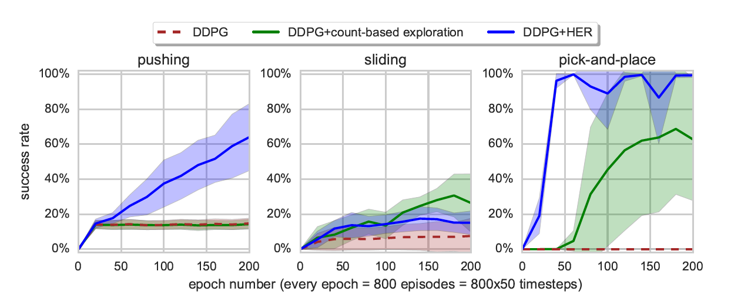
Experiments Single GOAL

Slide 11
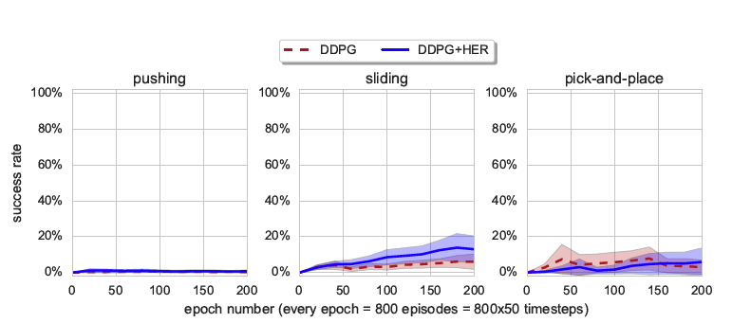
Comparison Dense Rewards
Notes:
explain shaped rewards

Slide 12
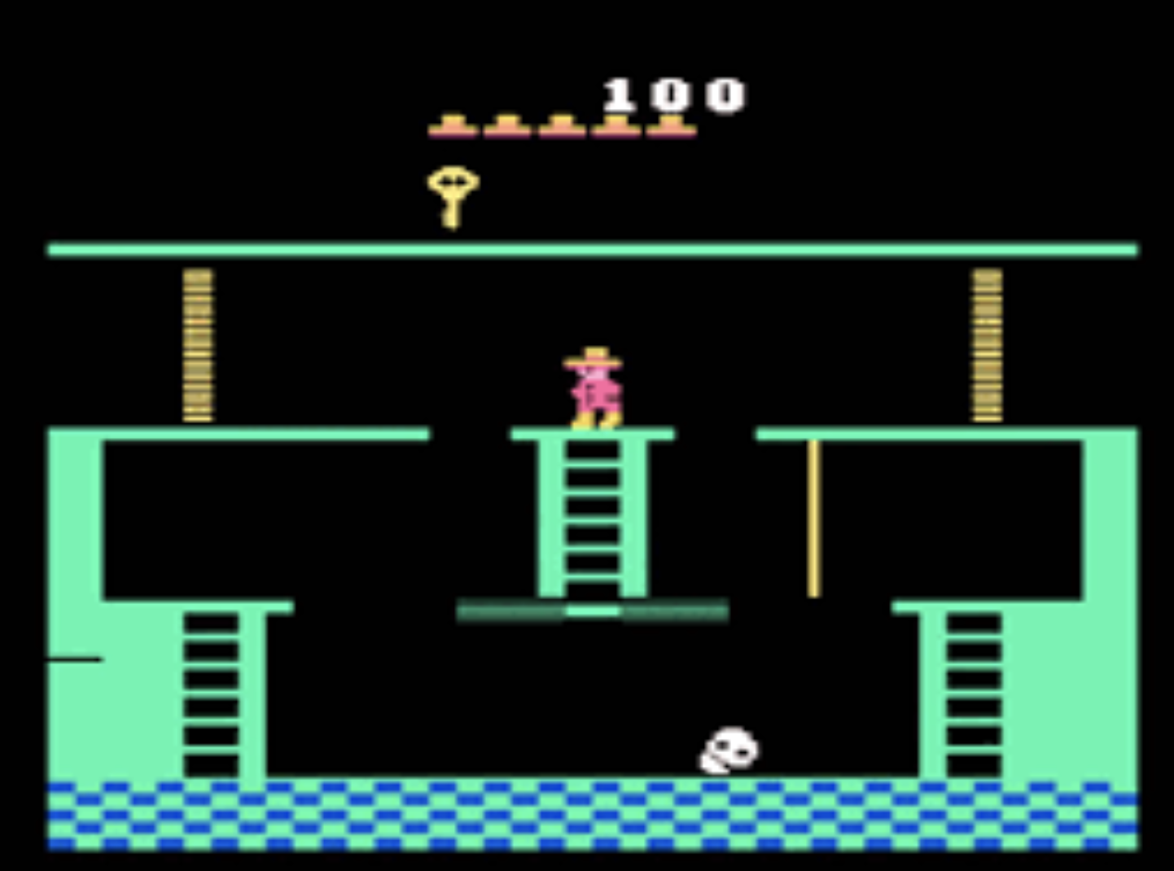
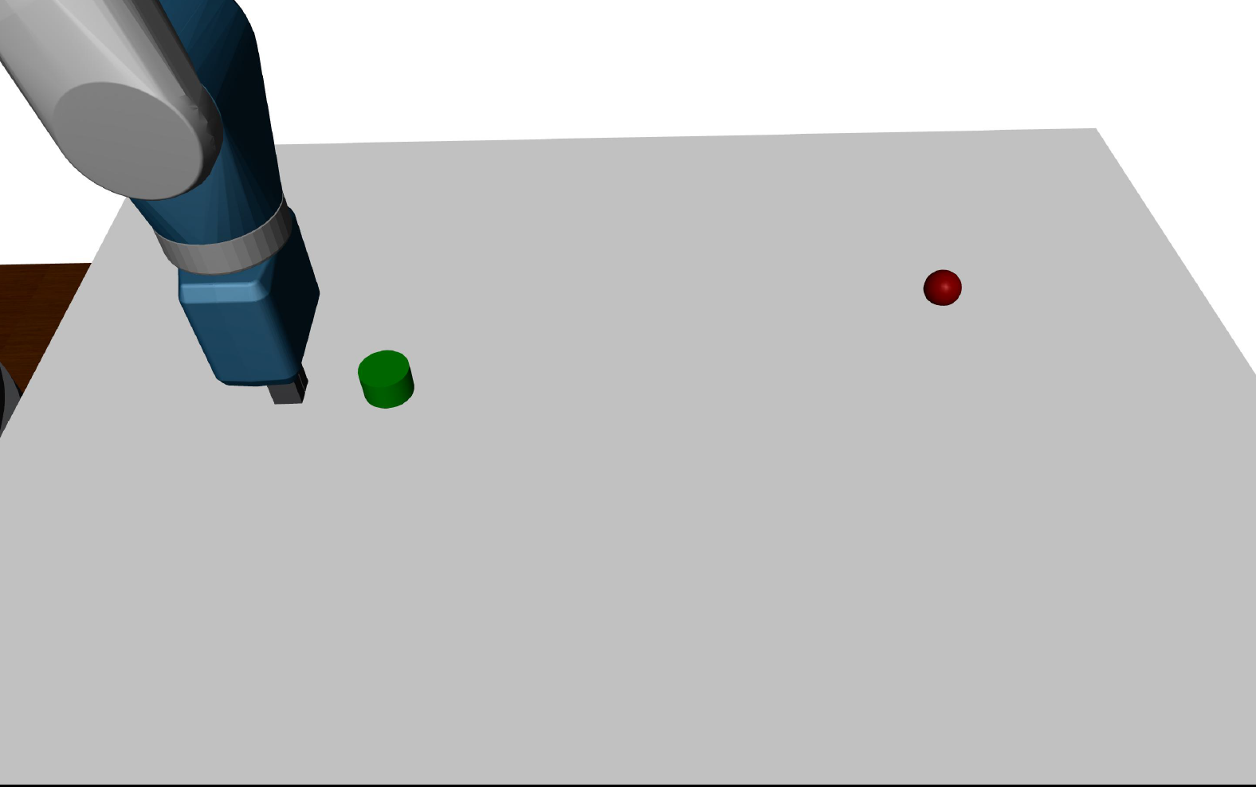
Conclusion
?

Slide 13
Learning self-imitating policies
Gangwani, Tanmay, Qiang Liu, and Jian Peng.
Notes:
slides: zu de visitation distribution slide (rho), discriminator slide,
M ihfüehre explizit

Slide 14
State visitation Distribution

Slide 15
Distance Between distributions

Slide 16
Jensen Shannon divergence
$$JSD\left(P∥Q\right)=\frac{1}{2}KL\left(P∥\frac{1}{2}\left(P+Q\right)\right)+\frac{1}{2}KL\left(Q∥\frac{1}{2}\left(P+Q\right)\right)$$

Slide 17
Policy gradient
$$∇_{θ}η\left(π_{θ}\right)=\left(1−v\right)Ε_{ρ_{π}(s,a)}\left[∇_{θ}log{ π}_{0}(a|s)Q^{r}(s,a)\right]−v∇_{θ}JSD(ρ_{π},ρ_{π_{E}})$$
new gradient
standard policy gradient
divergence gradient
Notes:
eta erklären. wenn policy wege rewards verbesse isch das de gradient . Log policy * irgenden measure vom return.
beschriibige uf de slide mit pfiili.

Slide 18
algorithm Self imitation learning
initialize empty replay memory M
initialize other parameters
for episode = 1 to M do {
generate batch of trajectories for each transition with $r_{1}=r(s,a)$ and $r_{2}=$reward given by Jensen Shannon divergence
update M using threshold
for minibatch t = 0 to N do {
calculate $g_{1}=∇_{θ}η^{r_{1}}\left(π_{θ}\right)$ with environment reward
calculate $g_{2}=∇_{θ}η^{r_{2}}\left(π_{θ}\right)$ with divergence reward
update policy with $\left(1−v\right)g_{1}+vg_{2}$
}
update expert policy using the new M
}

Slide 19
Limitations
good exploration
local minima
Notes:
wort diverse

Slide 20
Learning Multiple Policies
$$\max_{q}{E_{θ\sim q}}{η\left(θ\right)+αH(q)}$$
$$\left(1−v\right)Ε_{ρ_{π}(s,a)}\left[∇_{θ}log{ π}_{0}(a|s)Q^{r}(s,a)\right]−v∇_{θ}JSD(ρ_{π},ρ_{π_{E}})$$
Notes:
meh parameter, ned nur theta. q enthalted n policies, all gliichzitig interacte.

Slide 21
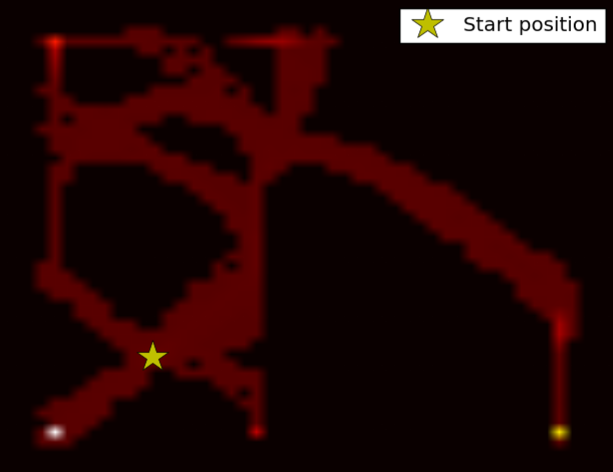
Experiments

Slide 22
Experiments
Notes:
screenshot vode tierli. sparse

Slide 23
Comparison
Hindsight experience replay
good for environments where goal can change
{States} == {Goals}
no strategy to avoid local minima
Self imitation learning
intended to find a single goal
{States} == {Goals} does not have to be satisfied
actively trying to explore whole state space
Notes:
sege dasses doch nunig so guet isch wie learning

Slide 24
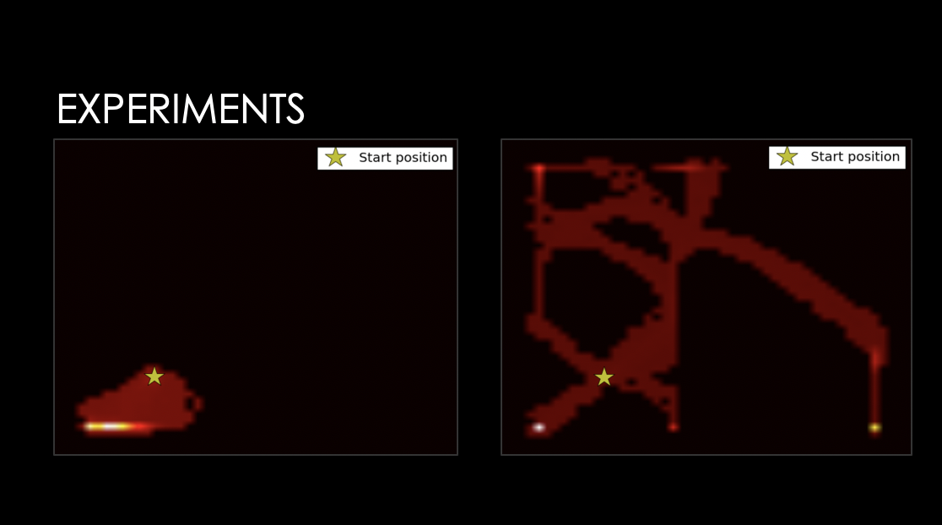
Questions ?

