Slide 1
Multi-Agent Deep Reinforcement Learning
Evolving intrinsic motivations for altruistic behavior
Wang, Jane X., et al. (2018)
Human-level performance in first-person multiplayer games with population-based deep reinforcement learning
Jaderberg, Max, et al. (2018)
Michael Seeber
30.4.2019

Slide 2
Social Dilemmas
Intertemporal Social Dilemma (ISD)
I am selfish
Conflict between individual and collective interests
Intertemporal Choice
Time
Current decisions affect future options

Slide 3
Social Dilemmas
Intertemporal Social Dilemma (ISD)
I am selfish
Conflict between individual and collective interests
Intertemporal Choice
Time
Current decisions affect future options

Slide 4
Social Dilemmas
Intertemporal Social Dilemma (ISD)
I am selfish
Conflict between individual and collective interests
Intertemporal Choice
Time
Current decisions affect future options

Slide 5
Social Dilemmas
Intertemporal Social Dilemma (ISD)
I am selfish
Conflict between individual and collective interests
Intertemporal Choice
Time
Current decisions affect future options

Slide 6
Why even care?
Cooperation

Slide 7
Evolving intrinsic motivations for altruistic behavior
Wang, Jane X., et al. (2018)

Slide 8
Introduction
Goal: Create agents that can solve ISDs
Current solutions:
Opponent modeling
Long-term planning
Remove hand crafting

Slide 9
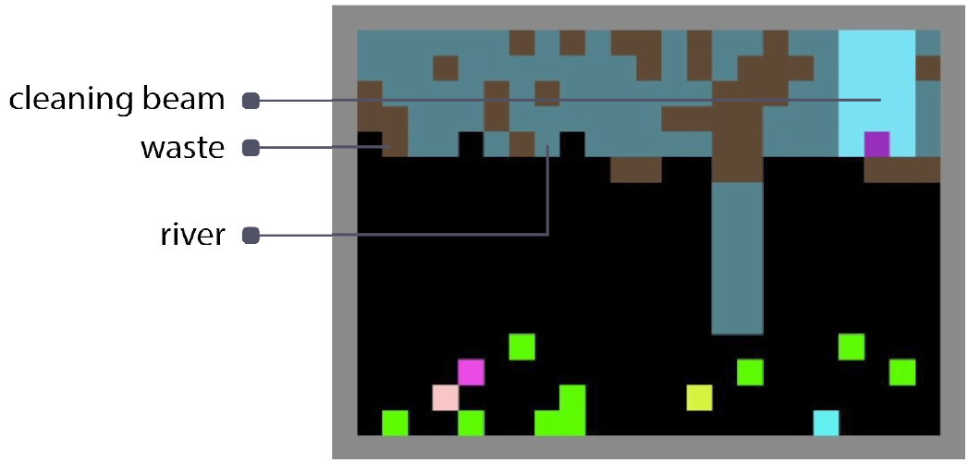
Cleanup Game
Goal: collect apples (+1 reward)
Game mechanics:
Spawn rate related to the cleanliness of a river
Dilemma: For apples to spawn, agents need to clean river → no direct reward

Slide 10
Harvest Game
Goal: collect apples (+1 reward)
Game mechanics:
Spawn rate related to the number of nearby apples
Dilemma: individual short-term quick reward
vs.
long-term high group reward

Slide 11
Theory
Idea: Optimize over distinct time scales

Slide 12
Theory
Total reward = extrinsic reward + intrinsic reward
$${ r}_{i}\left(s_{i}, a_{i}\right)=$$
$$r_{i}^{E}\left(s_{i}, a_{i}\right)$$
$$+$$
$$u_{i}(f_{i})$$

Slide 13
Theory
Total reward = extrinsic reward + intrinsic reward
$${ r}_{i}\left(s_{i}, a_{i}\right)=$$
$$r_{i}^{E}\left(s_{i}, a_{i}\right)$$
$$+$$
$$u_{i}(f_{i})$$

Slide 14
Reward aggregation
Retrospective
Check if other agents received a reward in the recent past
Rewards may not be aligned in time
Prospective
Estimate if other agents will get reward in near future

Slide 15
Reward aggregation
Retrospective
Check if other agents received a reward in the recent past
Rewards may not be aligned in time
Prospective
Estimate if other agents will get reward in near future

Slide 16
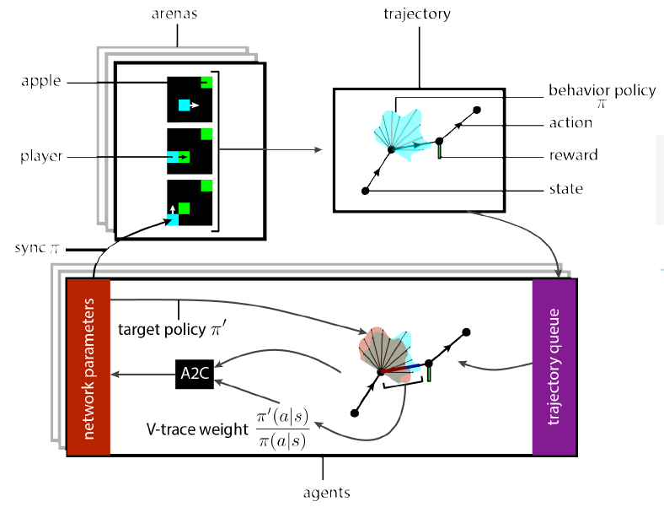
Training
Population of 50 agents
500 arenas running in parallel
Sampling:
Random matchmaking
Assortative matchmaking

Slide 17
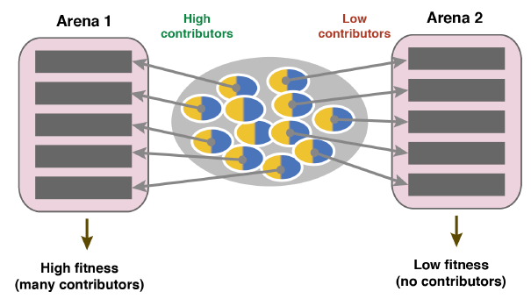
Matchmaking
Random matchmaking
Assortative matchmaking

Slide 18
Shared reward network

Slide 19
Results - Cleanup

Slide 20
Results - Harvest

Slide 21
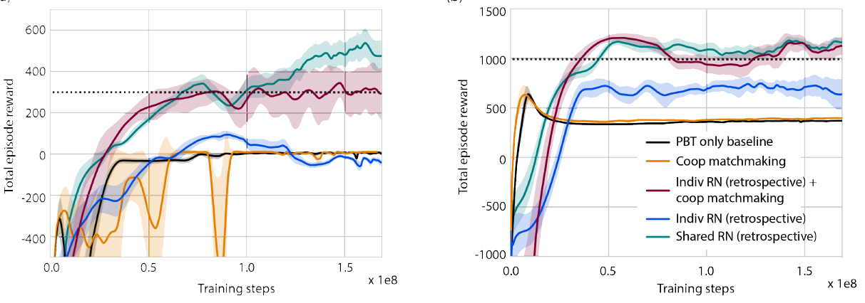
Results – Random vs Assortative (retrospective)
Cleanup
Harvest

Slide 22
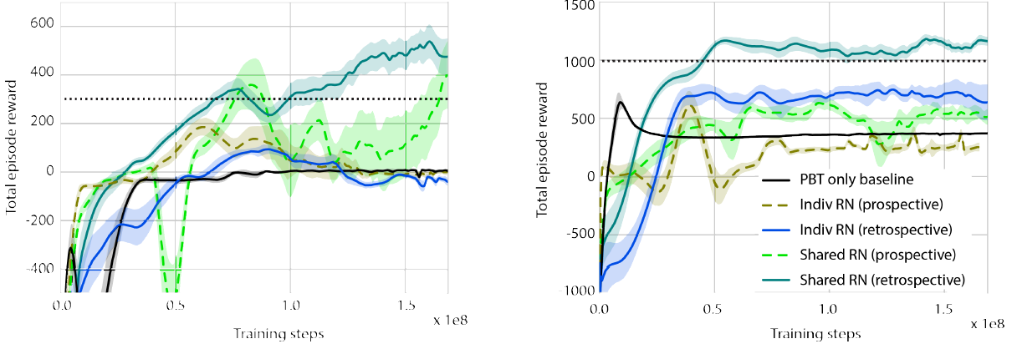
Results – Retrospective vs. Prospective
Cleanup
Harvest

Slide 23
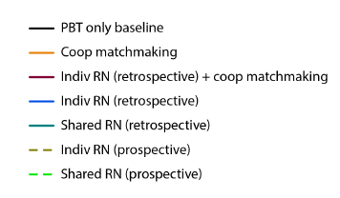
Results – Equality

Slide 24
Results - Tagging
Cleanup
Harvest

Slide 25
Recap
Examined if intrinsic rewards based on other agents enables cooperation evolve
Assortative matchmaking sufficient
Shared reward networks approach more robust

Slide 26
Human-level performance in first-person multiplayer games with population-based deep reinforcement learning
Jaderberg, Max, et al. (2018)

Slide 27
Introduction
They show for the first time, that an agent can achieve human-level performance in a popular 3D team based first-person video game

Slide 28
Quake III – Capture the Flag
Goal: Score as many as possible flag captures within 5 minutes

Slide 31
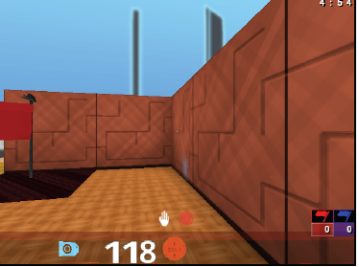
Problem
Game Points
$$a_{t} \sim π$$
Reward
RGB Input
Control action
Game outcome

Slide 32
Challenges
Sparse and delayed game outcome reward
No information about environment & other agents
Cooperation crucial for winning

Slide 33
FTW Agent
→ Maximize the probability of winning for the team

Slide 34
Optimization
$ρ_{t}=game point signal$
$$E_{π}\left[\sum_{t=0}^{T}{γ^{t}}r_{t}\right]$$
$$E_{π}\left[\sum_{t=0}^{T}{γ^{t}}w(ρ_{t})\right]$$
$$r_{t}=w(ρ_{t})$$

Slide 35
Optimization
$ρ_{t}=game point signal$
$$E_{π}\left[\sum_{t=0}^{T}{γ^{t}}r_{t}\right]$$
$$E_{π}\left[\sum_{t=0}^{T}{γ^{t}}w(ρ_{t})\right]$$
$$r_{t}=w(ρ_{t})$$

Slide 36
Optimization
$ρ_{t}=game point signal$
$$E_{π}\left[\sum_{t=0}^{T}{γ^{t}}w_{p}(ρ_{p, t})\right]$$
$$E_{π}\left[\sum_{t=0}^{T}{γ^{t}}r_{t}\right]$$
$$E_{π}\left[\sum_{t=0}^{T}{γ^{t}}w(ρ_{t})\right]$$
$$J_{inner}\left(π_{p}|w_{p}\right)=$$
$$jointly$$
$$optimise$$
$$r_{t}=w(ρ_{t})$$
$$J_{outer}\left(w_{p}, φ_{p}| π\right)=$$
$$(π_{p}^{w, φ}{}_{}^{′}s team wins | π_{l}^{w, φ})$$

Slide 37
Optimization
$ρ_{t}=game point signal$
$$E_{π}\left[\sum_{t=0}^{T}{γ^{t}}r_{t}\right]$$
$$E_{π}\left[\sum_{t=0}^{T}{γ^{t}}w_{p}(ρ_{p, t})\right]$$
$$J_{inner}\left(π_{p}|w_{p}\right)=$$
$$jointly$$
$$optimise$$
$$r_{t}=w(ρ_{t})$$
$$J_{outer}\left(w_{p}, φ_{p}| π\right)=$$
$$(π_{p}^{w, φ}{}_{}^{′}s team wins | π_{l}^{w, φ})$$

Slide 38
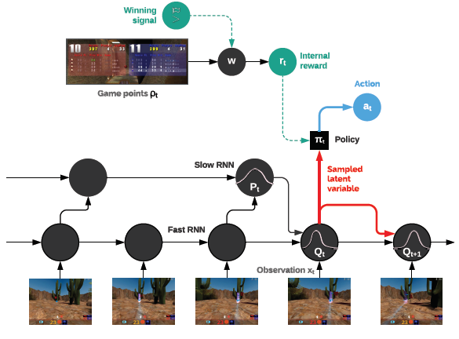
Architecture

Slide 39
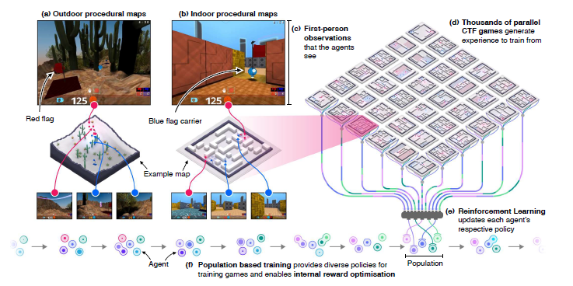
Training Architecture

Slide 40
FTW agent training progress

Slide 41
Results
FTW agents exceed win rate of humans
Humans were only able to win when paired up with a FTW agent (5%)
Exploitability of the FTW agent : 2 pros vs. 2 fixed FTW agents (25% after 12h)

Slide 42
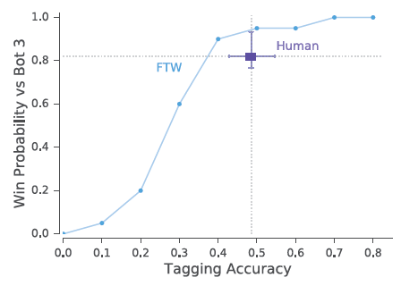
Human – Agent Differences
→ artificially reduced FTW agents tagging accuracy

Slide 44
Agent Visualization
https://www.youtube.com/watch?v=dltN4MxV1RI
from 02:21 to 02:51

Slide 45
Key Contributions
Internal reward function
→ to cope for hard credit assignment problem
Multi-timescale architecture
→ to allow for high level CTF strategies
Concurrent training of diverse populations
→ Generalizable skills

Slide 46
Example Tournament Games:
https://www.youtube.com/watch?v=dltN4MxV1RI
from 03:14

Slide 47
Thanks for you attention!
Questions?

