Slide 1
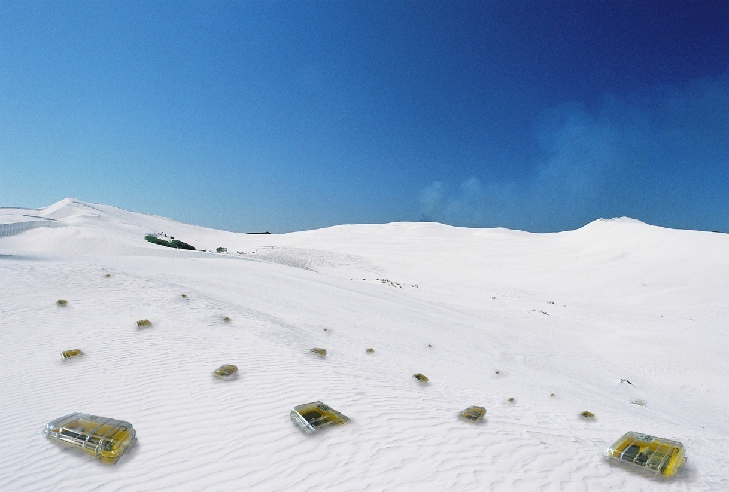

Introduction
Chapter 1

Slide 2
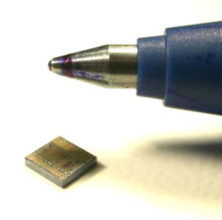

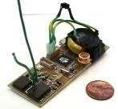






Today, we look much cuter!
And we’re usually carefully deployed
Radio
Power
Processor
Sensors
Memory

Slide 3
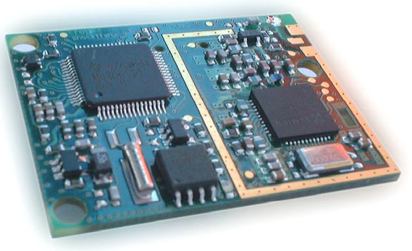
A Typical Sensor Node: TinyNode 584
[Shockfish SA, The Sensor Network Museum]
TI MSP430F1611 microcontroller @ 8 MHz
10k SRAM, 48k flash (code), 512k serial storage
868 MHz Xemics XE1205 multi channel radio
Up to 115 kbps data rate, 200m outdoor range
 | Current Draw | Power Consumption
uC sleep with timer on | 6.5 uA | 0.0195 mW
uC active, radio off | 2.1 mA | 6.3 mW
uC active, radio idle listening | 16 mA | 48 mW
uC active, radio TX/RX at +12dBm | 62 mA | 186 mW
Max. Power (uC active, radio TX/RX at +12dBm + flash write) | 76.9 mA | 230.7mW

Slide 4
After Deployment
multi-hop
communication

Slide 5
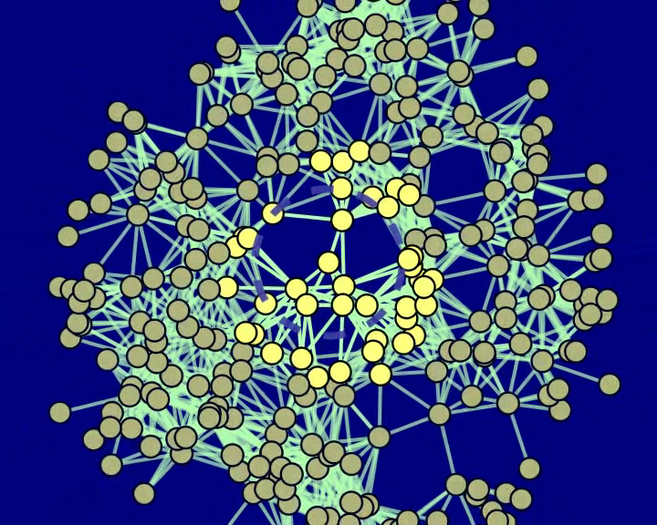

Visuals anyone?

Slide 6
Ad Hoc Networks vs. Sensor Networks
Laptops, PDA’s, cars, soldiers
All-to-all routing
Often with mobility (MANET’s)
Trust/Security an issue
  No central coordinator
Maybe high bandwidth
Tiny nodes: 4 MHz, 32 kB, …
Broadcast/Echo from/to sink
Usually no mobility
  but link failures
One administrative control
Long lifetime → Energy
There is no strict separation; more variants such as mesh or sensor/actor networks exist

Slide 7
Overview
Introduction
Application Examples
Related Areas
Course Overview
Literature
For CS Students: Wireless Communication Basics
For EE Students: Network Algorithms Overview

Slide 8
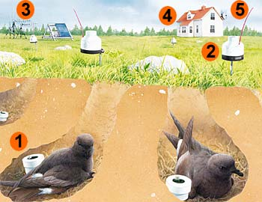
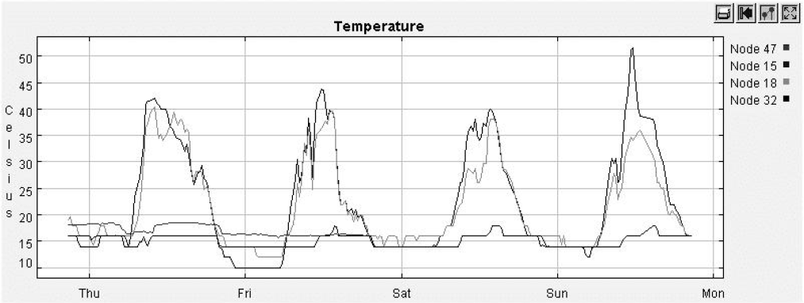
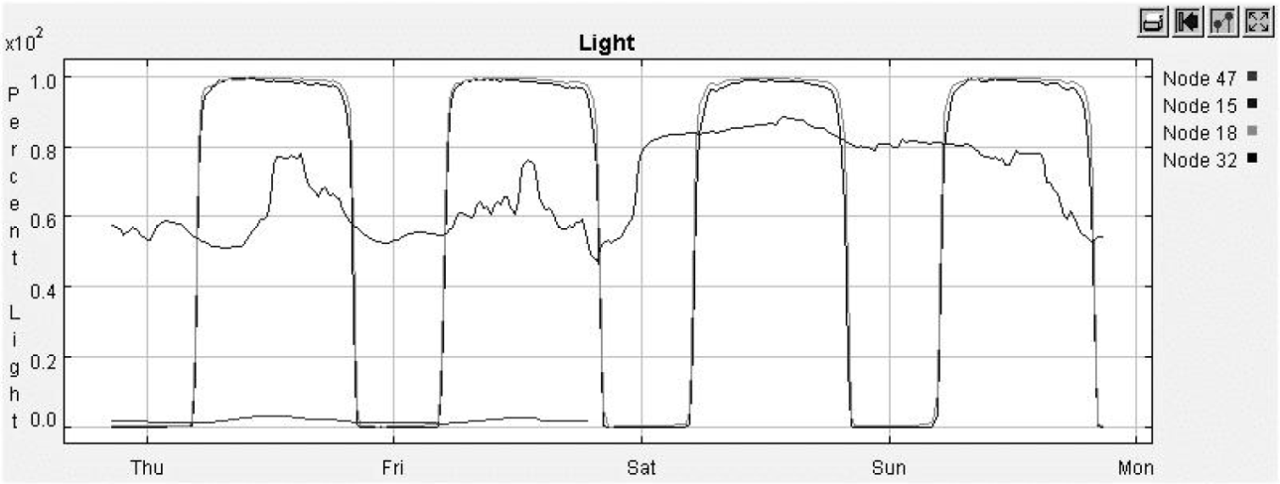
Animal Monitoring (Great Duck Island)
Biologists put sensors in underground nests of storm petrel
And on 10cm stilts
Devices record data about birds
Transmit to research station
And from there via satellite to lab

Slide 9
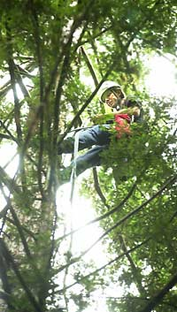
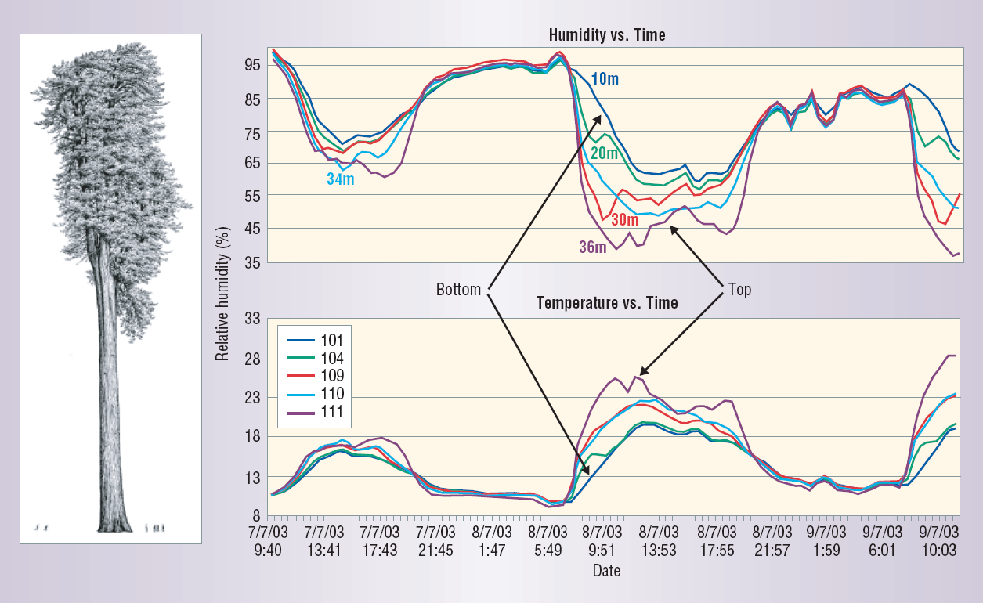
Environmental Monitoring (Redwood Tree)
Microclimate in a tree
10km less cables on a tree; easier to set up
Sensor Network = The New Microscope?

Slide 10
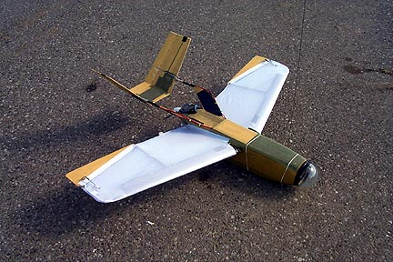
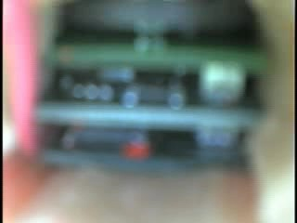
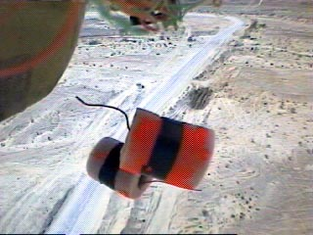
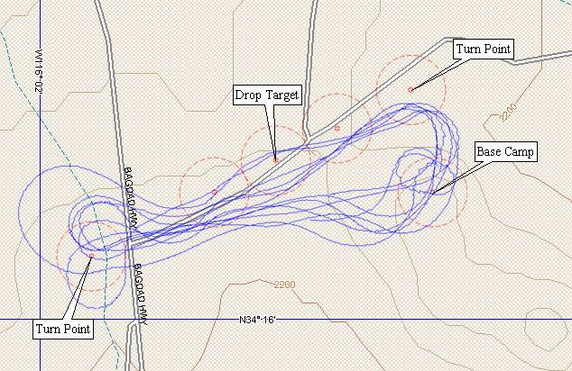
Vehicle Tracking
Sensor nodes (equipped with magnetometers) are packaged, and dropped from fully autonomous GPS controlled “toy” air plane
Nodes know dropping order, and use that for initial position guess
Nodes then
track
vehicles
(trucks
mostly)

Slide 11
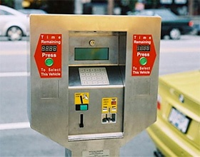
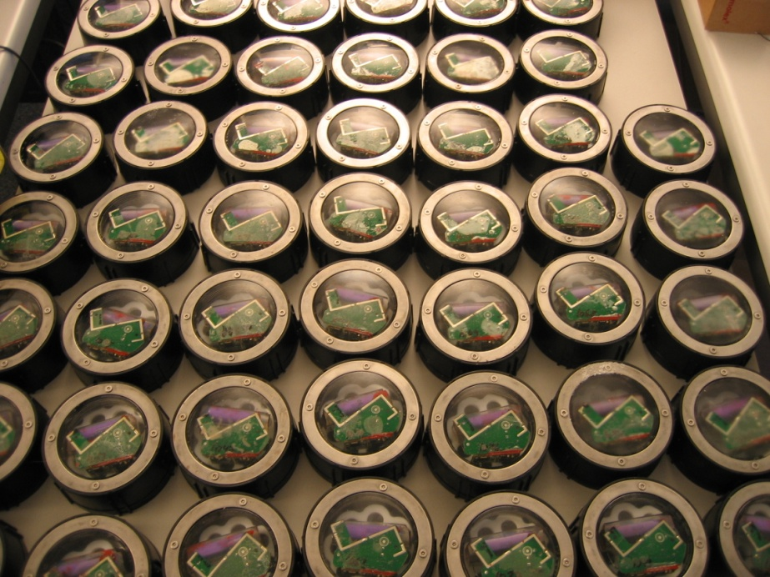
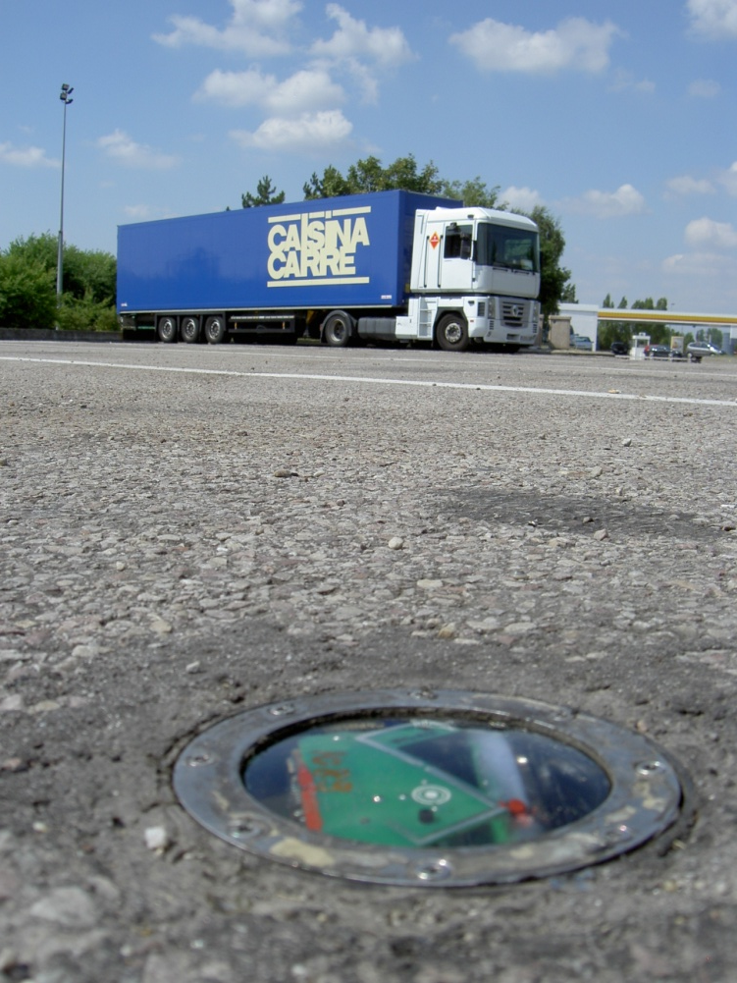
Smart Spaces (Car Parking)
The good: Guide cars towards empty spots
The bad: Check which cars do not have any time remaining
The ugly: Meter running out: take picture and send fine
Park!
Turn left!
30m to go…
Turn right!
50m to go…
[Matthias Grossglauser, EPFL & Nokia Research]

Slide 12
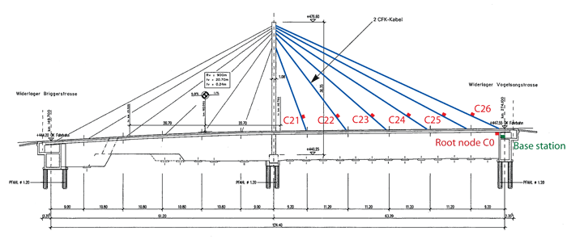
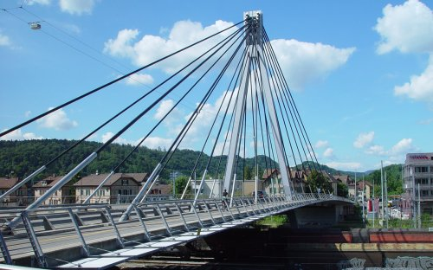
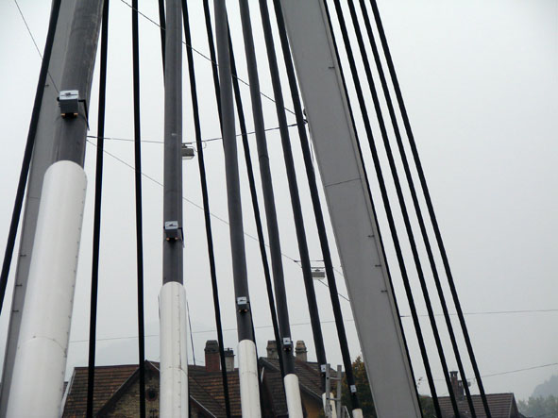
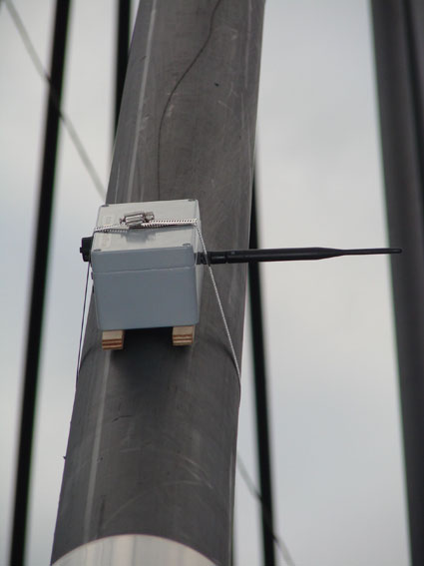
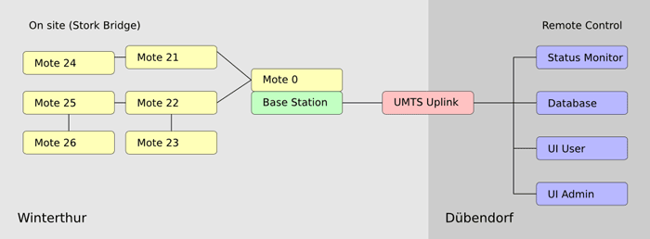
Structural Health Monitoring (Bridge)
Detect structural defects, measuring
temperature, humidity, vibration, etc.
Swiss Made [EMPA]

Slide 13

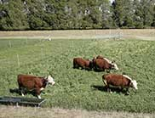
Virtual Fence (CSIRO Australia)
Download the fence to the cows. Today stay here, tomorrow go somewhere else.
When a cow strays towards the co-ordinates, software running on the collar triggers a stimulus chosen to scare the cow away, a sound followed by an electric shock; this is the “virtual” fence. The software also "herds" the cows when the position of the virtual fence is moved.
If you just want to make sure that cows stay together, GPS is not really needed…
Cows learn and need not to be shocked later… Moo!

Slide 14
Economic Forecast
Industrial Monitoring (35% – 45%)
  Monitor and control production chain
  Storage management
  Monitor and control distribution
Building Monitoring and Control (20 – 30%)
  Alarms (fire, intrusion etc.)
  Access control
Home Automation (15 – 25%)
  Energy management (light, heating, AC etc.)
  Remote control of appliances
Automated Meter Reading (10-20%)
  Water meter, electricity meter, etc.
Environmental Monitoring (5%)
  Agriculture
  Wildlife monitoring
[Jean-Pierre Hubaux, EPFL]

Slide 15
Related Areas
Ad Hoc & Sensor Networks
RFID
Mobile
Wireless
Wearable
…

Slide 16
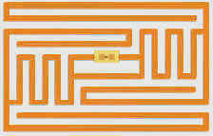
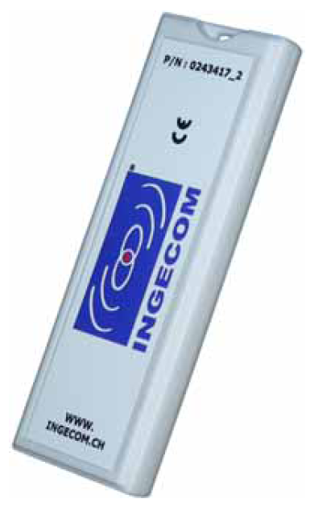
RFID Systems
Fundamental difference between ad hoc/sensor networks and RFID: In RFID there is always the distinction between the passive tags/transponders (tiny/flat), and the reader (bulky/big).
There is another form of tag, the so-called active tag, which has its own internal power source that is used to power the integrated circuits and to broadcast the signal to the reader. An active tag is similar to a sensor node.
More types are available, e.g. the semi-passive tag, where the battery is not used for transmission (but only for computing)

Slide 17
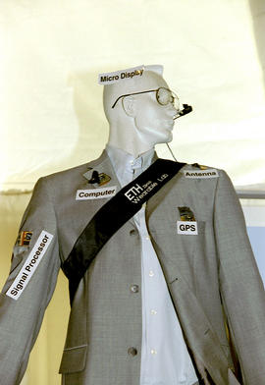
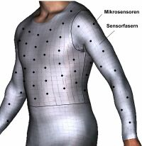
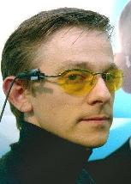
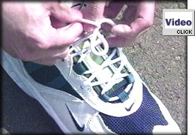
Wearable Computing / Ubiquitous Computing
Tiny embedded “computers”
UbiComp: Microsoft’s Doll
I refer to my colleague
Gerhard Troester and
his lectures & seminars
[Schiele, Troester]

Slide 18
Wireless and/or Mobile
Aspects of mobility
  User mobility: users communicate “anytime, anywhere, with anyone” (example: read/write email on web browser)
  Device portability: devices can be connected anytime, anywhere to the network
Wireless vs. mobile Examples
✗ ✗ Stationary computer
✗ ✓ Notebook in a hotel
✓ ✗ Historic buildings; last mile
✓ ✓ Personal Digital Assistant (PDA)
The demand for mobile communication creates the need for integration of wireless networks and existing fixed networks
  Local area networks: standardization of IEEE 802.11 or HIPERLAN
  Wide area networks: GSM and ISDN
  Internet: Mobile IP extension of the Internet protocol IP

Slide 19
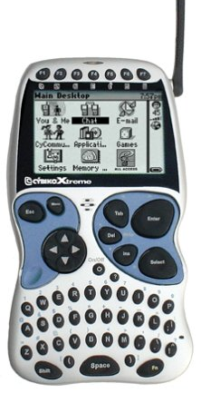
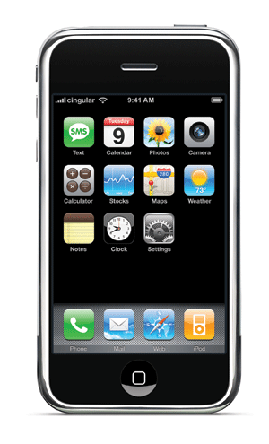
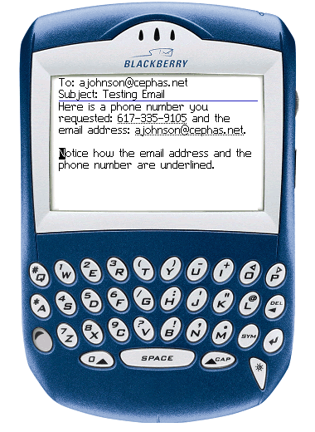
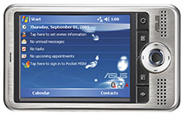
Wireless & Mobile Examples
Up-to-date localized information
  Map
  Pull/Push
Ticketing
Etc.
[Asus PDA, iPhone, Blackberry, Cybiko]

Slide 20
General Trend: A computer in 10 years?
Advances in technology
  More computing power in smaller devices
  Flat, lightweight displays with low power consumption
  New user interfaces due to small dimensions
  More bandwidth (per second? per space?)
  Multiple wireless techniques
Technology in the background
  Device location awareness: computers adapt to their environment
  User location awareness: computers recognize the location of the user and react appropriately (call forwarding)
“Computers” evolve
  Small, cheap, portable, replaceable
  Integration or disintegration?

Slide 21


Physical Layer: Wireless Frequencies
regulated
1 Mm
300 Hz
10 km
30 kHz
100 m
3 MHz
1 m
300 MHz
10 mm
30 GHz
100 μm
3 THz
1 μm
300 THz
VLF
LF
MF
HF
VHF
UHF
SHF
EHF
infrared
visible light
UV
twisted pair coax
ISM
AM SW FM

Slide 22
Frequencies and Regulations
ITU-R holds auctions for new frequencies, manages frequency bands worldwide (WRC, World Radio Conferences)

Slide 23
Course Overview
Application
Transport
Network
Link
Physical
1 Applications
8 Clock Sync
9 Positioning
14 Transport
13 Mobility
2 Geo-Routing
4 Data Gathering
12 Routing
5 Network Coding
6 MAC Practice
7 MAC Theory
3 Topology Control
10 Clustering
1 Basics
11 Capacity
Practice Theory

Slide 24
Course Overview: Lecture and Exercises
Maximum possible spectrum of theory and practice
New area, more open than closed questions
Each week, exactly one topic (chapter)
General ideas, concepts, algorithms, impossibility results, etc.
  Most of these are applicable in other contexts
  In other words, almost no protocols
Two types of exercises: theory/paper, practice/lab
Assistants: Philipp Sommer, Johannes Schneider
www.disco.ethz.ch → courses

Slide 25
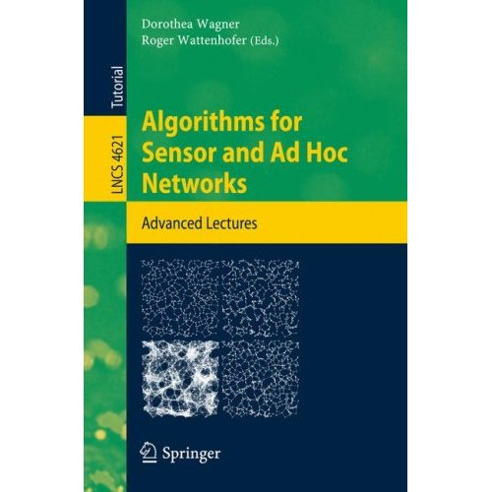
Literature

Slide 26
More Literature
Bhaskar Krishnamachari – Networking Wireless Sensors
Paolo Santi – Topology Control in Wireless Ad Hoc and Sensor Networks
F. Zhao and L. Guibas – Wireless Sensor Networks: An Information Processing Approach
Ivan Stojmeniovic – Handbook of Wireless Networks and Mobile Computing
C. Siva Murthy and B. S. Manoj – Ad Hoc Wireless Networks
Jochen Schiller – Mobile Communications
Charles E. Perkins – Ad-hoc Networking
Andrew Tanenbaum – Computer Networks
Plus tons of other books/articles
Papers, papers, papers, …

Slide 27
Rating (of Applications)
Area maturity
Practical importance
Theory appeal
First steps Text book
No apps Mission critical
Boooooooring Exciting

Slide 28
Open Problem
Well, the open problem for this chapter is obvious:
Find the killer application! Get rich and famous!!
…this lecture is only superficially about ad hoc and sensor networks. In reality it is about new (and hopefully exciting) networking paradigms!

Slide 29
For CS Students: Wireless Communication Basics
Brief history of communication
Frequencies
Signals
Antennas
Signal Propagation
Modulation

Slide 30
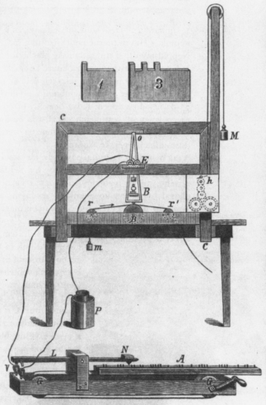
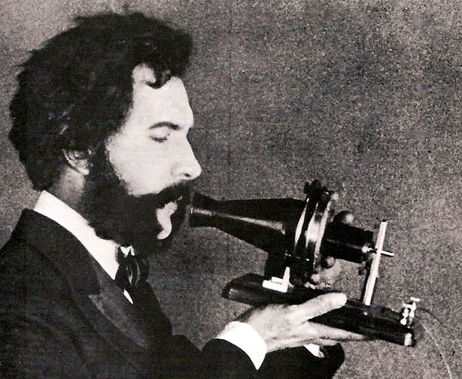
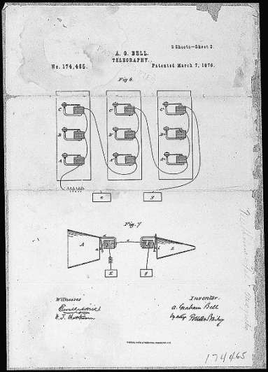
A brief history of communication
Electric telegraph invented in 1837 by Samuel Morse
First long distance transmission between Washington,
D.C. and Baltimore, Maryland in 1844:
«What hath God wrought»
Invention of the telephone by Alexander Graham Bell in 1875

Slide 31
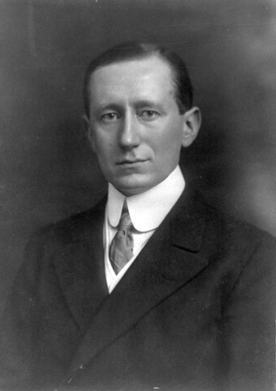
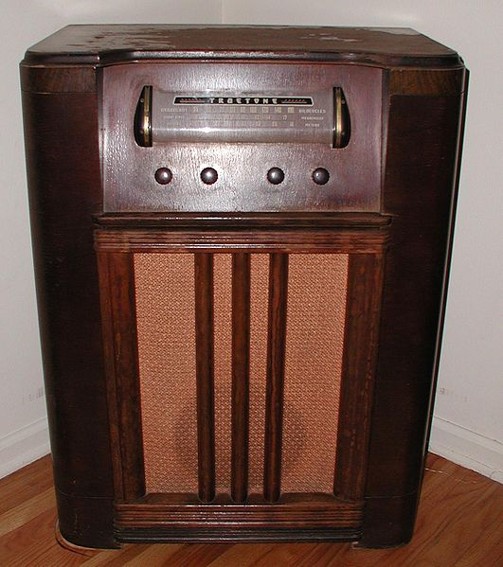
Going Wireless
Guglielmo Marconi demonstrates first wireless
telegraph in 1896.
A wireless telegraph service is established between
France and England in 1898.
1901 first wireless communication accross the atlantic
First amplitude modulation (AM) radio transmission
in 1906
Edwin Howard Armstrong invents
frequency modulation (FM) radio in 1935
Digital Audio Broadcasting (DAB) since late 90’s

Slide 32
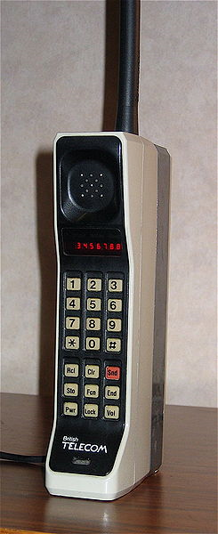
Wireless Telephony
First experiments with mobile phone systems in 1950s
Fully automated mobile phone system for vehicles
launched in Sweden around 1960
First generation (1G): cellular networks in Japan (1979)
Second generation (2G): GSM introduced in 1990s
Digital network, SMS, roaming
Third generation (3G): high-speed data networks (UMTS)

Slide 33
Block Diagram of a Wireless Communication System
Modulation is required to transfer data over a wireless channel
Transmitter
Data In
Modulator
Antenna
Wireless Channel
Receiver
Data Out
Demodulator
Antenna

Slide 34
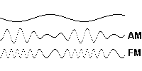
Modulation and demodulation
analog
baseband
signal
digital
data
digital
modulation
analog
modulation
101101001
radio transmitter
radio
carrier
analog
baseband
signal
digital
data
analog
demodulation
synchronization
decision
101101001
radio receiver
radio
carrier
Modulation in action:

Slide 35
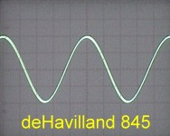
Periodic Signals
g(t) = A_{t} sin(2π f_{t} t + φ_{t})
Amplitude A
frequency f [Hz = 1/s]
period T = 1/f
wavelength λ
with λf = c
(c=3∙10⁸ m/s)
phase φ
φ* = -φT/2π [+T]
A
φ*
0
t
T

Slide 36
Different representations of signals
For many modulation schemes not all parameters matter.
A [V]
A [V]
I = A sin ϕ
t [s]
ϕ
R = A cos ϕ
ϕ*
f [Hz]
amplitude domain
frequency spectrum
phase state diagram

Slide 37
Digital modulation
Modulation of digital signals known as Shift Keying
Amplitude Shift Keying (ASK):
  very simple
  low bandwidth requirements
  very susceptible to interference
Frequency Shift Keying (FSK):
  needs larger bandwidth
Phase Shift Keying (PSK):
  more complex
  robust against interference
1
0
1
t
1
0
1
t
1
0
1
t

Slide 38
Advanced Phase Shift Keying
BPSK (Binary Phase Shift Keying):
  bit value 0: sine wave
  bit value 1: inverted sine wave
  Robust, low spectral efficiency
  Example: satellite systems
QPSK (Quadrature Phase Shift Keying):
  2 bits coded as one symbol
  symbol determines shift of sine wave
  needs less bandwidth compared to BPSK
  more complex
I
R
1
0
10
I
11
R
00
01

Slide 39
Modulation Combinations
Quadrature Amplitude Modulation (QAM)
combines amplitude and phase modulation
it is possible to code n bits using one symbol
2^{n} discrete levels, n=2 identical to QPSK
bit error rate increases with n, but less errors compared to comparable PSK schemes
Example: 16-QAM (4 bits = 1 symbol)
Symbols 0011 and 0001 have the
same phase, but different amplitude.
0000 and 1000 have different phase,
but same amplitude.
Used in 9600 bit/s modems
I
0010
0001
0011
0000
R
1000

Slide 40
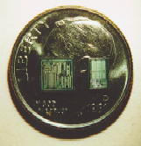
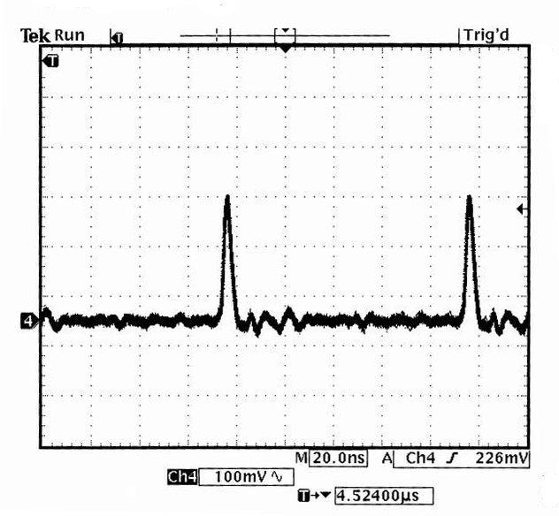
Ultra-Wideband (UWB)
An example of a new physical paradigm.
Discard the usual dedicated frequency band paradigm.
Instead share a large spectrum (about 1-10 GHz).
Modulation: Often pulse-based systems. Use extremely short duration pulses (sub-nanosecond) instead of continuous waves to transmit information. Depending on
application 1M-2G pulses/second

Slide 41
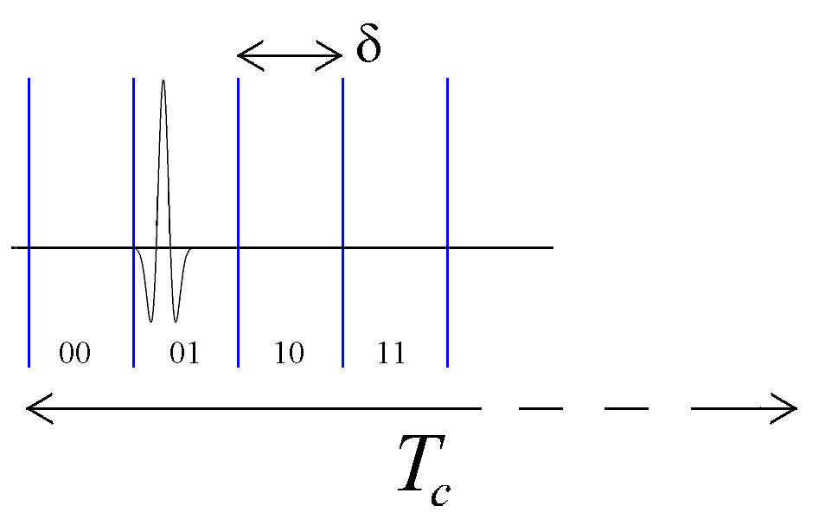
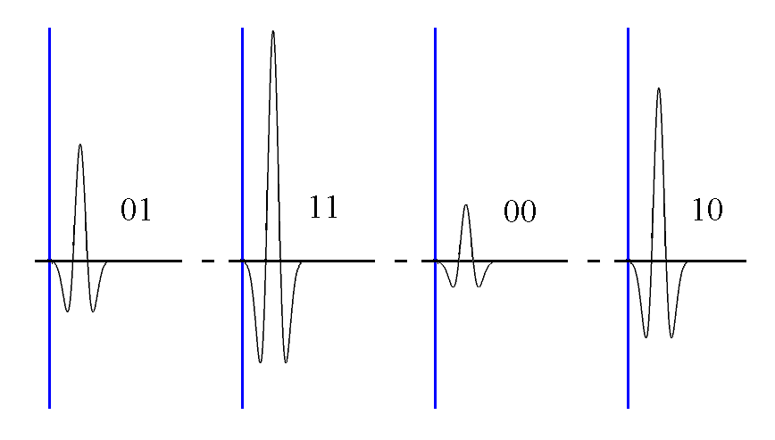
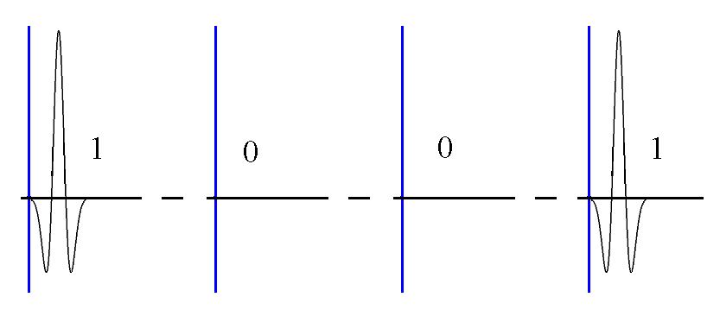
UWB Modulation
PPM: Position of pulse
PAM: Strength of pulse
OOK: To pulse or not to pulse
Or also pulse shape

Slide 42
Antennas: isotropic radiator
Radiation and reception of electromagnetic waves, coupling of wires to space for radio transmission
Isotropic radiator: equal radiation in all three directions
Only a theoretical reference antenna
Radiation pattern: measurement of radiation around an antenna
Sphere: S = 4π r²
z
y
Ideal isotropic radiator
x

Slide 43
Antennas: simple dipoles
Real antennas are not isotropic radiators but, e.g., dipoles with lengths λ/2 as Hertzian dipole or λ/4 on car roofs or shape of antenna proportional to wavelength
Example: Radiation pattern of a simple Hertzian dipole
λ/4
λ/2
z
z
y
simple
dipole
x
y
x
side view (xz-plane)
side view (yz-plane)
top view (xy-plane)

Slide 44
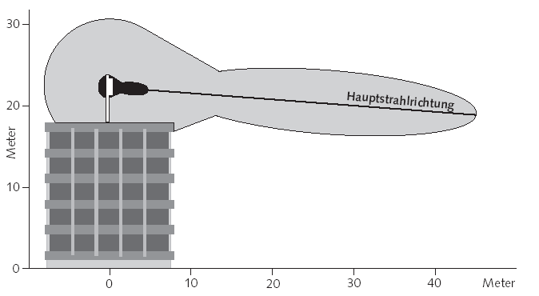
Antennas: directed and sectorized
Often used for microwave connections or base stations for mobile phones (e.g., radio coverage of a valley)
z
y
directed
antenna
x/y
x
side (xz)/top (yz) views
side view (yz-plane)
[Buwal]
y
y
sectorized
antenna
x
x
top view, 3 sector
top view, 6 sector

Slide 45
Antennas: diversity
Grouping of 2 or more antennas
  multi-element antenna arrays
Antenna diversity
  switched diversity, selection diversity
    receiver chooses antenna with largest output
  diversity combining
    combine output power to produce gain
    cophasing needed to avoid cancellation
Smart antenna: beam-forming, MIMO, etc.
λ/2
λ/2
λ/4
λ/2
λ/4
λ/2
+
+
ground plane

Slide 46
Signal propagation ranges, a simplified model
Propagation in free space always like light (straight line)
Transmission range
  communication possible
  low error rate
Detection range
  detection of the signal
  possible
  no communication
  possible
Interference range
  signal may not be
  detected
  signal adds to the
  background noise
sender
transmission
distance
detection
interference

Slide 47
Signal propagation, more accurate models
Free space propagation
Two-ray ground propagation
P_{s}, P_{r}: Power of radio signal of sender resp. receiver
G_{s}, G_{r}: Antenna gain of sender resp. receiver (how bad is antenna)
d: Distance between sender and receiver
L: System loss factor
¸: Wavelength of signal in meters
h_{s}, h_{r}: Antenna height above ground of sender resp. receiver
Plus, in practice, received power is not constant („fading“)

Slide 48
Attenuation by distance
Attenuation [dB] = 10 log₁₀ (transmitted power / received power)
Example: factor 2 loss = 10 log₁₀ 2 ≈ 3 dB
In theory/vacuum (and for short distances), receiving power is proportional to 1/d², where d is the distance.
In practice (for long distances), receiving
power is proportional to 1/d^{α}, α = 4…6.
We call α the path loss exponent.
Example: Short distance, what is
the attenuation between 10 and 100
meters distance?
Factor 100 (=100²/10²) loss = 20 dB
α = 2…
15-25 dB drop
received power
α = 4…6
LOS
NLOS
distance

Slide 49
Attenuation by objects
Shadowing (3-30 dB):
  textile (3 dB)
  concrete walls (13-20 dB)
  floors (20-30 dB)
reflection at large obstacles
scattering at small obstacles
diffraction at edges
fading (frequency dependent)
shadowing
reflection
scattering
diffraction

Slide 50
Multipath propagation
Signal can take many different paths between sender and receiver due to reflection, scattering, diffraction
Time dispersion: signal is dispersed over time
Interference with “neighbor” symbols: Inter Symbol Interference (ISI)
The signal reaches a receiver directly and phase shifted
Distorted signal depending on the phases of the different parts
signal at sender
signal at receiver

Slide 51
Effects of mobility
Channel characteristics change over time and location
  signal paths change
  different delay variations of different signal parts
  different phases of signal parts
quick changes in power received (short term fading)
Additional changes in
  distance to sender
  obstacles further away
slow changes in average power
received (long term fading)
Doppler shift: Random frequency modulation
power
short
term fading
long term
fading
t

Slide 52
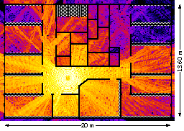


Real World Examples

Slide 53
For EE Students: Network Algorithms Basics
A Motivating Example: Steiner Tree
Complexity and Hardness
Approximation Algorithms
Minimum Spanning Tree

Slide 54

Connect with Minimal Cost
Given n points in the plane, for instance n-1 sensors and one sink.
Can you connect all these points at minimum cost?
Example: Connect the four
nodes A, B, C, D, using a wire
of minimum cost (minimum
total length)
Optimal Solution: A spanning tree
known as Steiner tree, with two
additional helper points (Steiner
points)
Jakob Steiner: Swiss
mathematician, 1796 – 1863

Slide 55
Steiner Tree Facts
It is known that Steiner points must have a degree of 3, and that the three edges incident to such a point must form three 120 degree angles.
It follows that the maximum number of Steiner points that a Steiner tree can have is n − 2, where n is the initial number of given points.
How can we compute the optimal Steiner tree?

Slide 56
Time Complexity
The time complexity of an algorithm quantifies the amount of time taken by an algorithm to run as a function of the size of the input to the problem, e.g. time = 5n³ + 17n – 2.
Time complexity is commonly computed by simply counting the number of elementary operations (such as additions or multiplications) performed by the algorithm, where an elementary operation takes a one time unit.
Often multiplicative constants and lower order terms are suppressed, and the answer is given in “big Oh” notation,
e.g. 5n³ + 17n – 2 = O(n³).
Since an algorithm may take a different amount of time even on inputs of the same size, one commonly focuses on the so-called worst-case time complexity, the maximum amount of time taken on any (including the worst) input of size n.

Slide 57
Hardness
A time complexity which is polynomial in the input is usually considered feasible, e.g. O(n¹⁰⁰⁰) is okay.
An algorithm becomes problematic if its time complexity is not polynomial anymore, e.g. exponential such as O(1.1^{n}).
In this example the first function may look scarier than the second, but for large enough n, the second function is much larger (well, after all it grows exponentially).
In layman’s terms, if a problem is NP-hard, then it is a “difficult” problem. For problems that are NP-hard it is generally believed that there is no polynomial time algorithm which can solve the problem. However, this is just a conjecture. If you can proof it, you get very famous.
The Steiner tree problem is known to be NP-hard.

Slide 58
What can one do if a problem is hard?
If you are lazy, you may take it as a excuse to propose a heuristic (an algorithm without quality guarantees).
Another way to go is to propose so-called fixed parameter algorithms. Some algorithms with exponential running time are still much better than others, e.g. O(1.1^{n}) is much faster than O(n^{n}) or O(n!)
A very popular alternative is to propose so-called approximation algorithms. These are polynomial-time algorithms which cannot guarantee to find the optimum, but they can guarantee to find a solution which is at most a factor c worse than the (unknown) optimum.
Is there an approximation algorithm for the Steiner tree problem?

Slide 59
Steiner Tree Approximations?
What if you connect all the nodes directly to some arbitrarily chosen (root) node?
  How much worse than the optimum solution will this be?
Alternatively we might connect the nodes with the minimum cost spanning tree that does not use additional (Steiner) points. Such a spanning tree is known as the Minimum Spanning Tree (MST).
  How can we compute such an MST?
  How much worse than the optimum solution will this be?
Indeed, for the Euclidean Steiner Tree problem there is even a polynomial-time approximation scheme (PTAS). This means that one can approximate the optimal solution up to a factor 1+ε, for an arbitrarily small ε > 0. However, the running time will grow as a function of ε.

Slide 60
Minimum Spanning Tree
There are several simple algorithms that can compute the MST quickly. For instance the following:
Choose the closest two nodes which are not yet connected (through a path) and connect them, until all nodes are connected by a spanning tree.
Exercise: Proof that this is optimal.

