Slide 1
Computer Systems &
Distributed Systems
Exercise Session 9

Slide 2
Contents & Order
Theory Recap
Assignment 9: Quiz, solve together
Assignment 8: Solutions

Slide 3
Theory recap

Slide 4
Consistency
Operations: access/manipulation on objects
Start time: f∗
End time: f†
Executions: set of operations
Executions restricted to a single node are executed sequentially
What about distributed systems?

Slide 5
Consistency models
Linearizability: ~one global order
Sequential consistency: per-node order
Quiescent consistency: ordering around quiescent phases
Linearizability ⇒ Sequential consistency
Linearizability ⇒ Quiescent consistency
Linearizability and quiescent consistency are composable (if every view restricted to an object is consistent then whole execution is consistent)

Slide 6
Linearizability
E is linearizable if there exists semantically equivalent sequential sequence S such that:
f<g in E ⇒ f<g in S
Usually easiest when looking at linearization points:
A
o.write(1)
o.read() → 1
B
o.write(2)
o.read() → 2
time

Slide 7
Linearizability
E is linearizable if there exists semantically equivalent sequential sequence S such that:
f<g in E ⇒ f<g in S
Usually easiest when looking at linearization points:
A
o.write(1)
o.read() → 1
B
o.write(2)
o.read() → 2
S
o.write(1) < o.read() → 1 < o.write(2) < o.read() → 2
Notes:
“Animation” by next slide

Slide 8
Sequential consistency
E is sequentially consistent if there exists semantically equivalent sequential sequence S such that:
f<g on the same node in E ⇒ f<g in S
Can mentally “shift” the execution threads w.r.t each other, but have to keep on node order.
A
o.write(1)
o.read() → 1
B
o.write(2)
o.read() → 2
time
Notes:
“Animation” by next slide

Slide 9
Sequential consistency
E is sequentially consistent if there exists semantically equivalent sequential sequence S such that:
f<g on the same node in E ⇒ f<g in S
Can mentally “shift” the execution threads w.r.t each other, but have to keep on node order.
A
o.write(1)
o.read() → 1
B
o.write(2)
o.read() → 2
o.write(1) < o.read() → 1 < o.write(2) < o.read() → 2
S

Slide 10
Quiescent consistency
E is quiescent consistent if there exists semantically equivalent sequential sequence S such that for every quiescent point t:
g ends before t and h start after t ⇒ g < h in S
I.e. separate operations before the quiescent point and operations after, but else any order is fine
Silence
A
o.write(1)
o.read() → 1
B
o.write(2)
o.read() → 2
o.write(1) < o.read() → 1 < o.write(2) < o.read() → 2
S

Slide 11
Happened-before relation
f → g (f happened before g) if:
if f < g on same node, or
f is send, and g corresponding receive, or
if there exists h such that f → h and h → g (transitivity)
induces happened-before consistency (= sequential consistency)

Slide 12
Logical clock
Logical clock:
Family of functions c_v such that for g on node u and h on node v:
g → h ⇒ c_u(g) < c_v(h)
Can think of c_u as a function that assigns timestamps to operations on node u.
Strong logical clock:
same, but additionally: g → h ⇐ c_u(g) < c_v(h)

Slide 13
Lamport’s clock
Lamport’s clock is a logical clock, but not strong

Slide 14
Lamport’s clock example
A
local op
1
send(m,2)
2
B
recv
3
send(m’,4)
4
C
local op
1
local op
2
recv
5
physical time
all init with 0
Notes:
Point out example of why it’s not a strong logical clock.

Slide 15
Vector clock
Similar to Lamport’s, but keep counter for all other nodes as well
⇒ Strong logical clock

Slide 16
Vector clock example
A
local op
(1,0,0)
send(m,(2,0,0))
(2,0,0)
B
recv
(2,1,0)
send(m’,(2,2,0))
(2,2,0)
C
local op
(0,0,1)
local op
(0,0,2)
recv
(2,2,2)
physical time
all init with (0,0,0)

Slide 17
Consistent Snapshots
Consistent snapshot = consistent cut + in transit messages
Never see an effect without its cause
A
local op
send(m)
B
recv
send(m’)
C
local op
local op
recv
physical time
inconsistent cut consistent cut

Slide 18
Consistent Snapshots
Algorithm idea:
some node saves local state and initiates snapshot with snap message
other nodes send their state to initiator and add snap tag to future message
upon receive of untagged message m, send m to initiator

Slide 19
Measure of concurrency
Measure of concurrency:
µ = # consistent snapshots in E
µ_s = # consistent snapshots in sequential execution
= 1 + q_1 + q_2 + … + q_n
µ_c = # consistent snapshots in entirely concurrent execution
= (1 + q_1) * (1 + q_2) … (1 + q_n)
(q_i = # operations on node i)

Slide 20
Time terminology
Clock error model:
ξ = jitter (unpredictable noise)
δ = drift (predictable clock error [ppm])
Top: wall-clock time t*
Bot: drifting clock
(regular but too fast)
Top: wall-clock time t*
Bot: jittering clock
(irregular/noisy)

Slide 21
Network Time Protocol (NTP)
Clock synchronization algorithm
Node u adjusts by: +θ =
u
t_u
t’_u
v
t_v
t’_v
physical time
δ t’_v-t_v δ
here transmission delay
t’_u-t_u

Slide 22
NTP example
Goal: synchronization after NTP, i.e. t’_u + θ = t’_v + δ
δ = 65ms
u
231ms
363ms
v
135ms
137ms
137ms+65ms
physical time
65ms
65ms
+θ = (135 - 231 + 137 - 363) / 2 = -161
t’_u + θ = 363 - 161 = 202 = 137 + 65 = t’_v + δ

Slide 23
GPS
Idea:
Want to find location, i.e. coordinates x, y, z
Receive satellite signal with their location and the the send time
⇒ Solve system of equations to get x, y, z
transmission delay * speed of signal = distance to sender
Combine distance to sender and location of sender to get own location.
Need 3 senders because in 3D

Slide 24
GPS
Problem: The receiver’s time might not be accurate
⇒ send time - receive time is inaccurate transmission delay
⇒ inaccurate distance to sender
Solution: add degree of freedom to system of equations ⇒ need one more satellite signal to solve
⇒ 4 unknowns: x, y ,z ,θ
unknown time offset
receive time send time
coordinates of satellite s

Slide 25
GPS implementation
Satellites uses a Pseudo-Random Noise (PRN) sequence of 1023 bits for signal transmission
Only 50 bit/s per satellite
a PRN is unique to a satellite
Additional challenges:
Doppler Shifts
Which bit of signal are we receiving at the moment? (delay)
⇒ Acquisition is a search over the possible PRNs of all the satellites, all possible doppler shifts and all possible delays
Allows the receiver to track a signal.

Slide 26
Improving GPS
Assisted GPS (A-GPS):
reduce transmission delay and TTFF (time-to-first-fix) by fetching satellite orbit data from internet
Differential GPS (DGPS):
User with exact location checks error of observed satellite distance, and helps other users with this knowledge
Collective detection:
Check how well a hypothesis of a location matches the received signal.
Can check multiple hypotheses and take most likely one as possible truth.
Prevent spoofing by observing that hypothesis doesn’t match received signal.

Slide 27
Assignment 9: Quiz

Slide 28
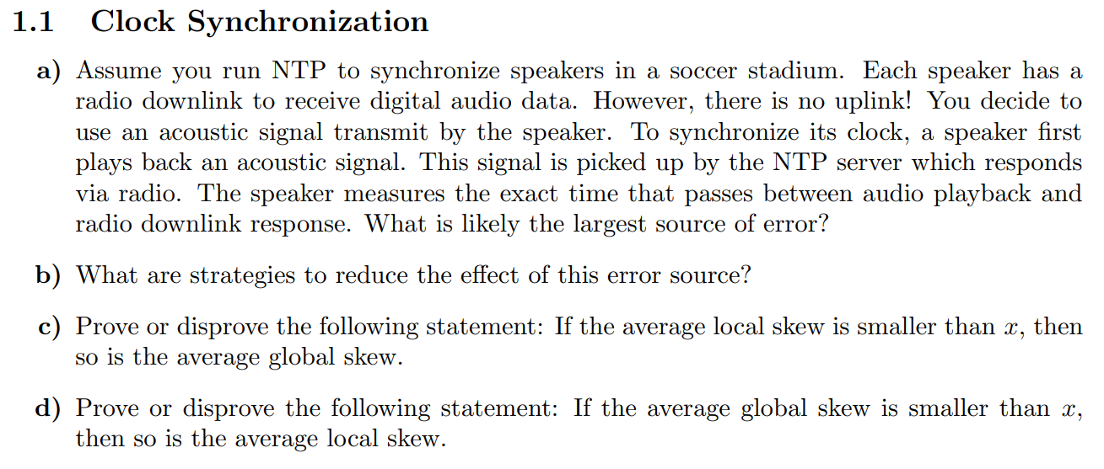

Slide 30
Assignment 8: Solutions

Slide 35
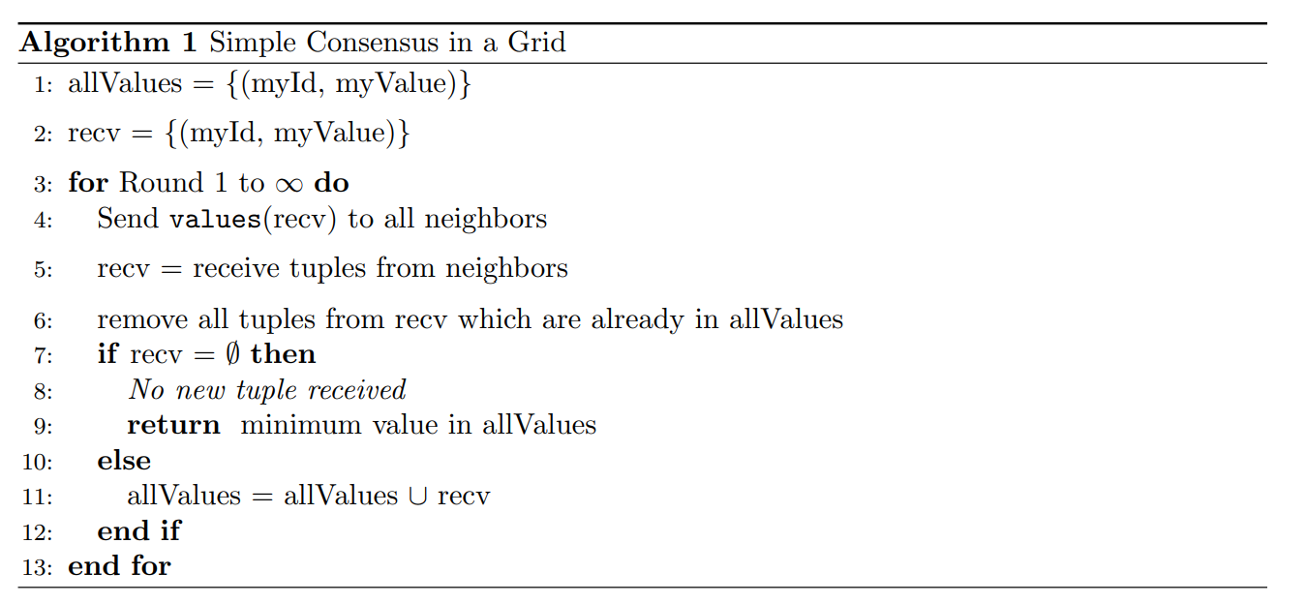

Slide 37
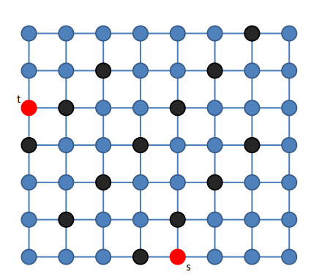

Slide 38
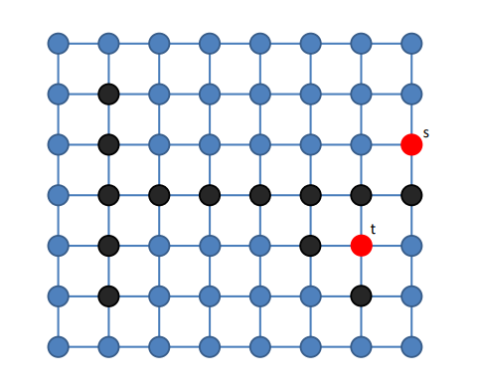

Slide 41
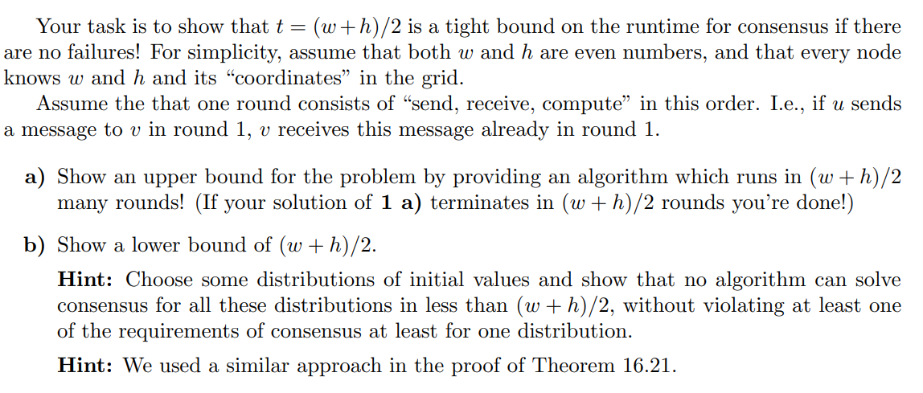

Slide 44
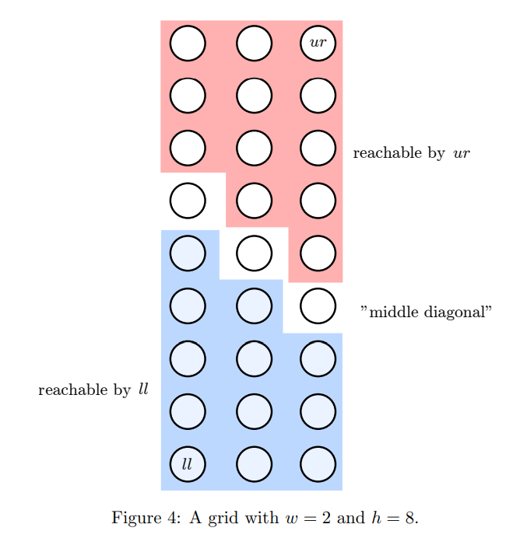

Slide 45
